Slide 1
Basquiat
and all that Jazz

Slide 2
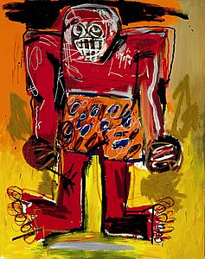
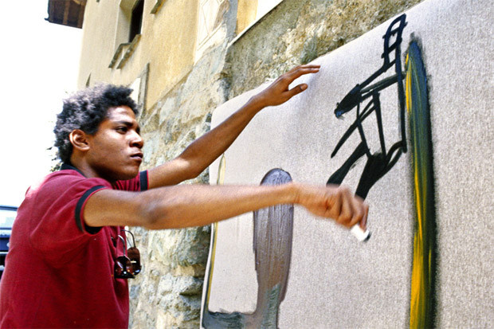
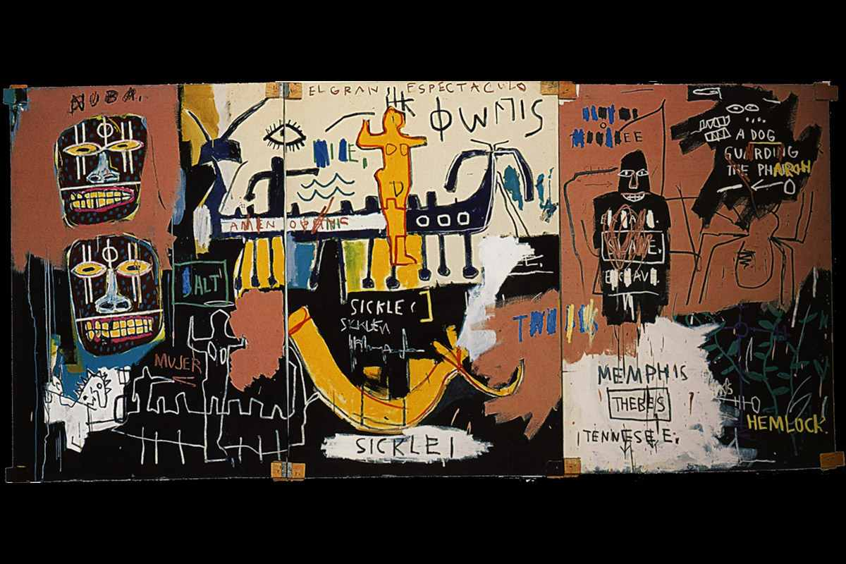
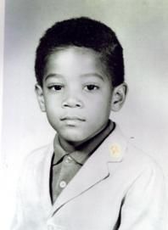
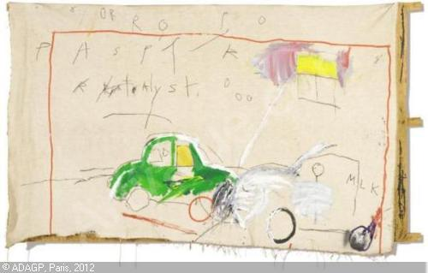
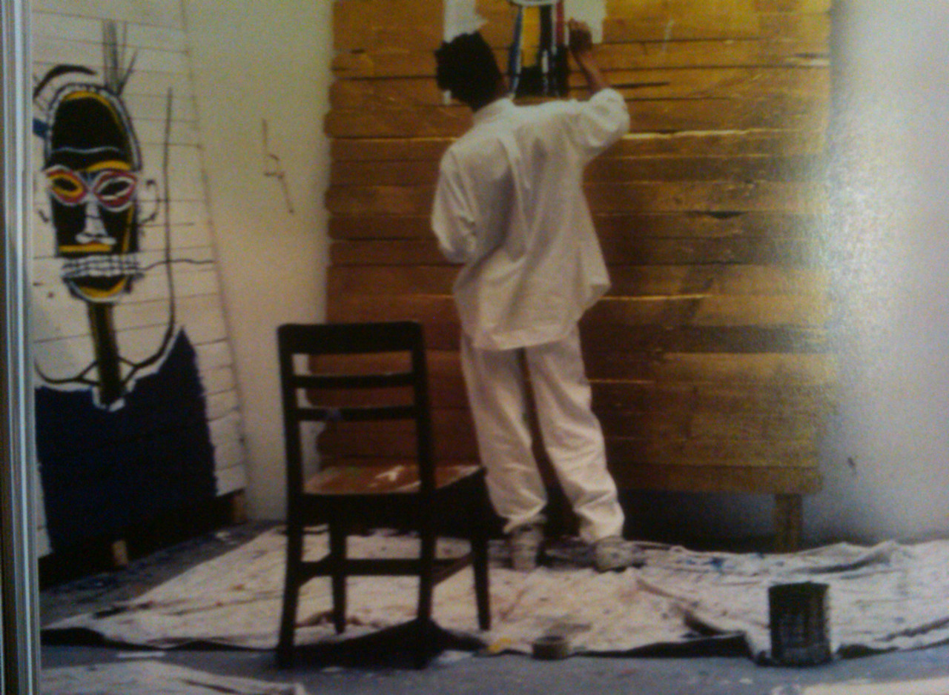
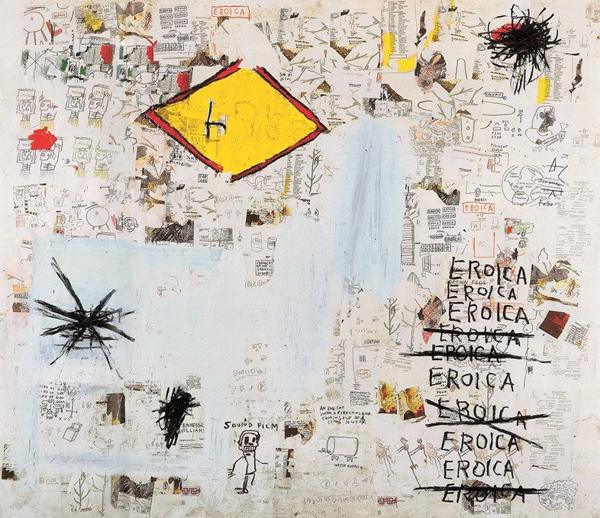
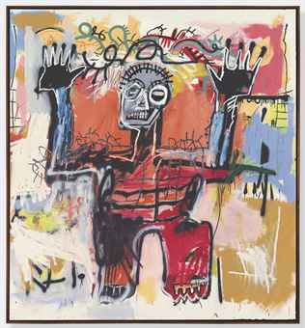
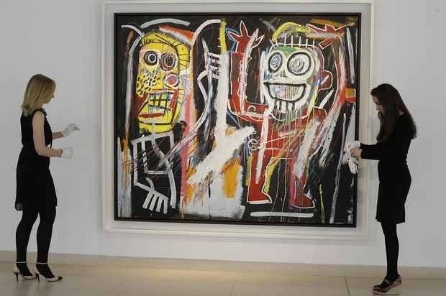
Click on an image to learn more…………..
https://www.youtube.com/watch?v=IxBX2orLe5c
December 22, time line August 12, 1988

Slide 3
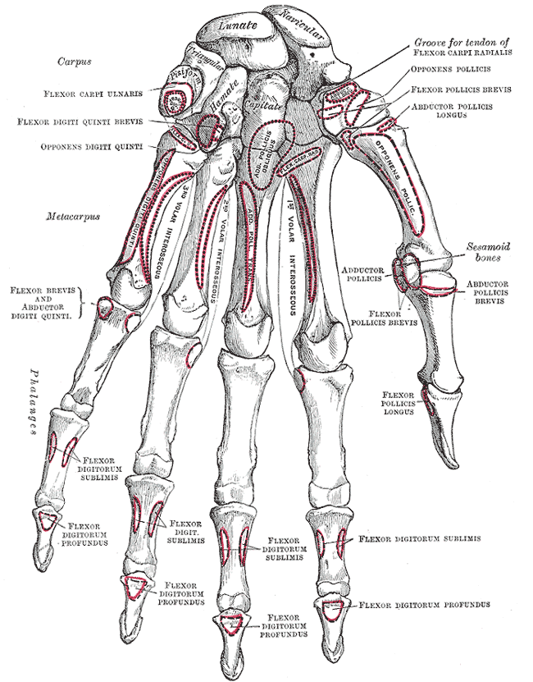
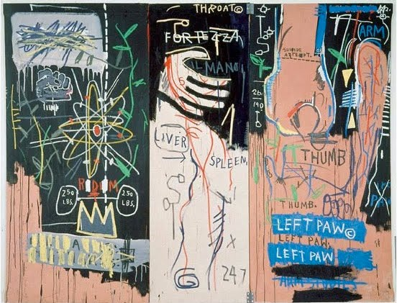
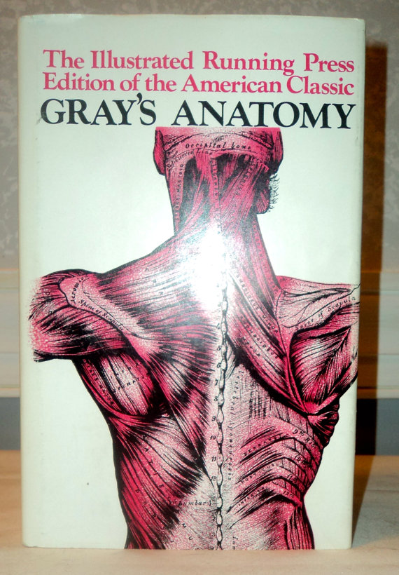
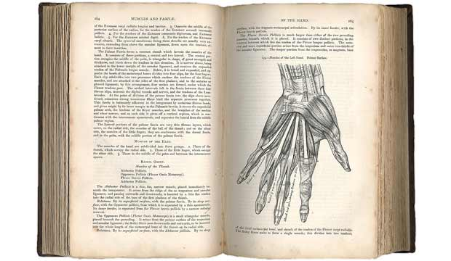
Aged six, Basquiat was hit by a car in an accident which led to him having a splenectomy. Whilst recovering from the operation, his mother gave him a copy of Gray’s Anatomy; the medical textbook would have a profound influence on him: in 1981 he named his avant-garde industrial band Gray, in reference to the volume, and in his later work he often used motifs of feet, the human body and words laid over images.

Slide 4
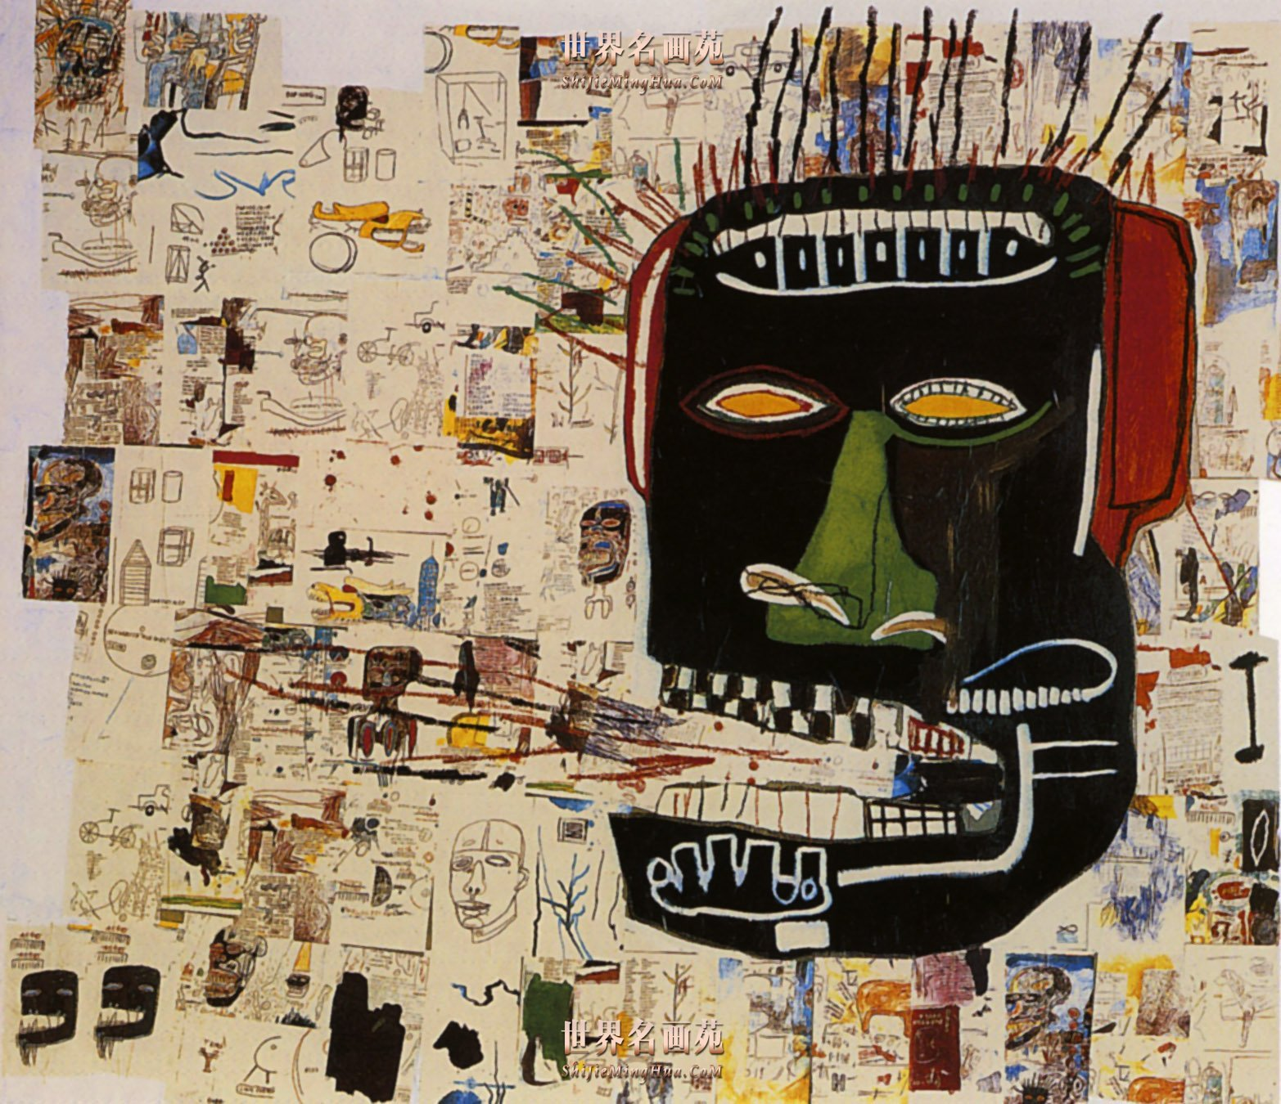
By the time he was 11, Basquiat was trilingual in French, English and Spanish; Gerard was of Haitian descent, and his mother Matilde of Puerto Rican.

Slide 5
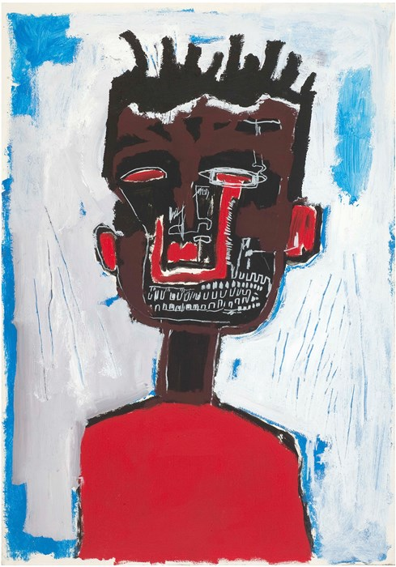
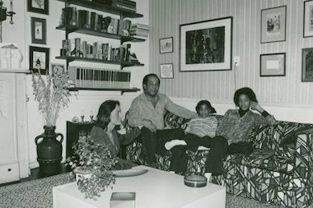
Self-Portrait, 1984 © Estate of Jean-Michel Basquiat. Licensed by Artestar, New York
Growing up Basquiat was precocious. His accountant father Gerard used to bring home scraps of paper from work for his four-year-old son to draw on. Eleven years later, and two years before he decided to leave school, Basquiat ran away from home. His father recalled that when he found him in a park, his son told him, “Papa, I will be very famous one day.”

Slide 6
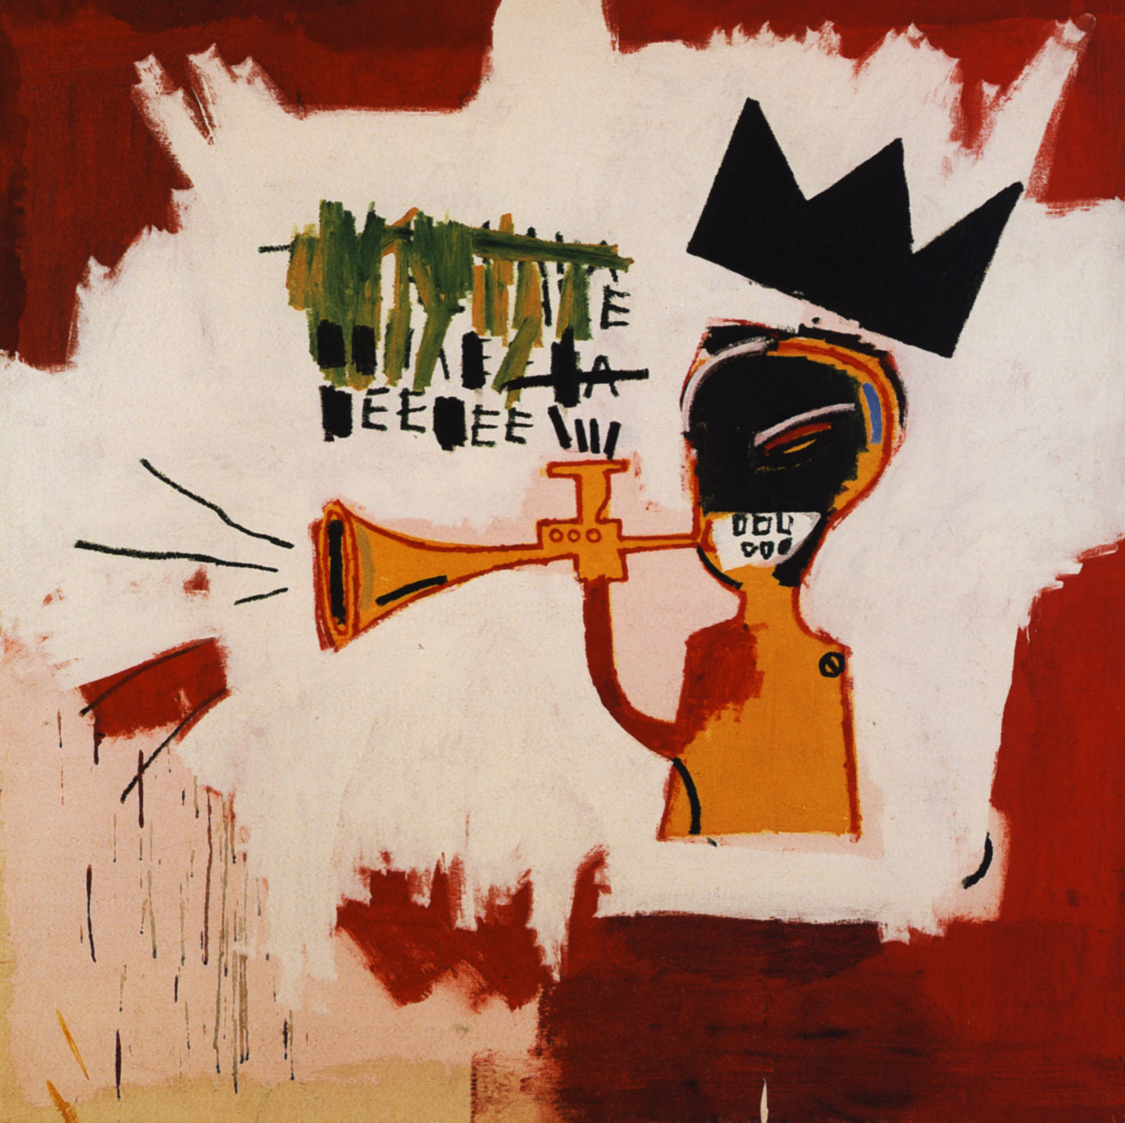
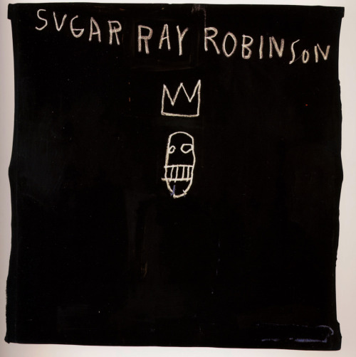
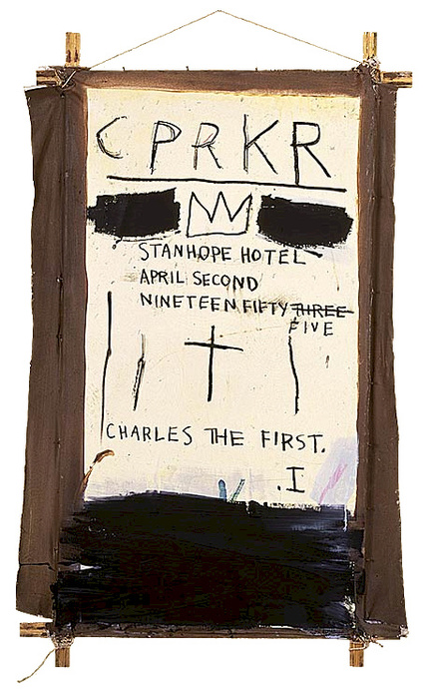
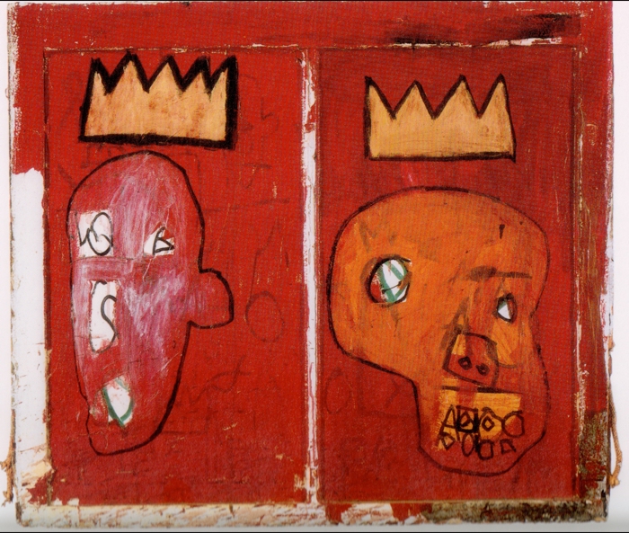
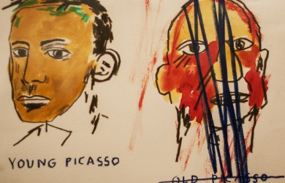
Basquiat’s Crowns A crown appears frequently in the early work of Jean-Michel Basquiat signaling his ambition and understanding of art history.
Basquiat creates his own monarch using the crown to denote the iconic importance of his own heroes.
Click on me

Slide 7
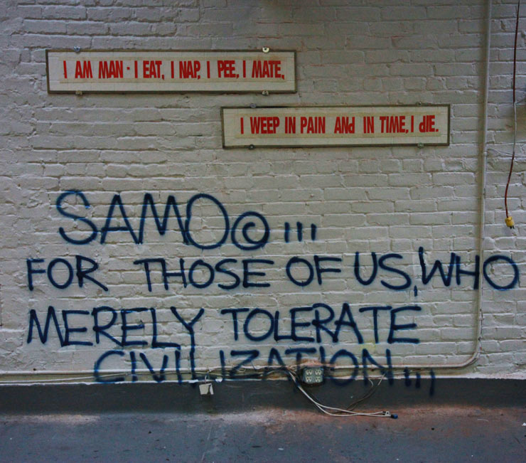
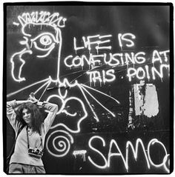
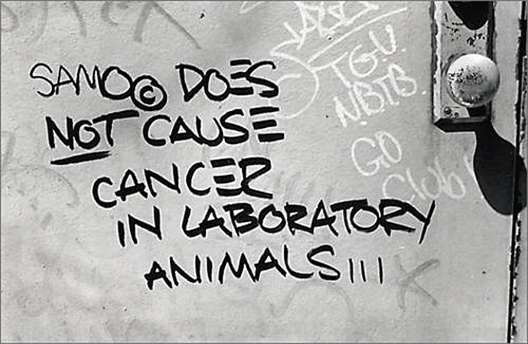
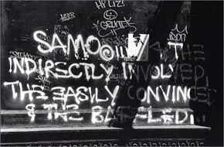
One of Jean-Michel’s first art projects was SAMO, a graffiti collaboration with his friend and past classmate Al Diaz. The two would spray the tag of their character (which stood for “Same Old Shit”) around the streets of Manhattan. But at the start of the 1980s, “SAMO IS DEAD” started to appear throughout the city; the pair had fallen out, and the project was over.

Slide 8
https://www.youtube.com/watch?v=eXjR-y0WH-I
The art critic Rene Ricard had a hand in bringing fame to the young New York artist. In December 1981 Ricard published “The Radiant Child”, an article that would later provide the name of a documentary on Basquiat’s life.

Slide 9
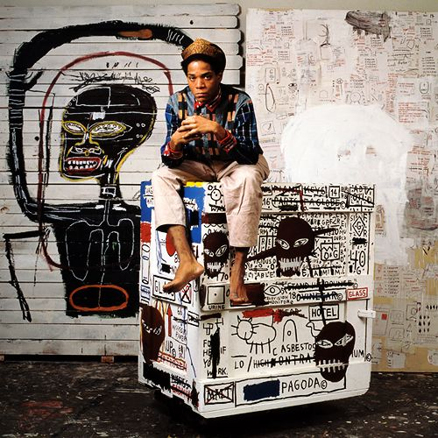
Basquiat’s paint ended up on much more than canvas. He liked to work on whatever was in front of him, from refrigerators to lab coats, shipping crates to typewriters. And he liked to work in an Armani suit – when finished, he would go out, still dressed in the paint-splattered clothing.

Slide 10
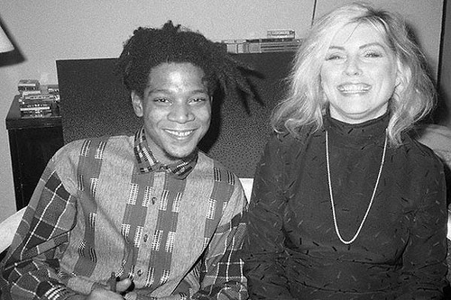
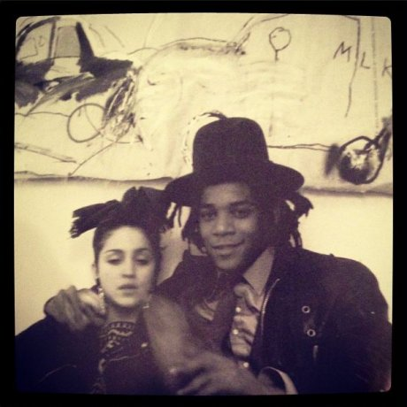
https://www.youtube.com/watch?v=pHCdS7O248g
In the early 1980s, Andy Warhol and painter Jean-Michel Basquiat began a series of collaborative paintings. Like Warhol, Jean-Michel Basquiat constructed a persona that he presented to the public that was contradictory to who he truly was. During press interviews, Andy Warhol also gave contradictory statements about his past. Emerging first out of the Grafitti Art movement, Basquiat choose SAMO as his “tag” referring to “Same Ol’. Basquiat soon found himself on the A list which included may popstars and artist of the time

Slide 11
The Nile – 1983
Acrylic, crayon on canvas, 172.5 x 358 cm
The Nile is one of many pieces of Basquiat art that explore his cultural heritage and this particular painting is full of symbolic imagery that relates to the slave trade. The word sickle appears below the slave ship representing the pillaging of the African people, while Memphis and Thebes are mentioned as they were important cities in ancient Egypt, but Jean-Michel Basquiat links it with modern day Memphis Tennessee and the use of slaves. The Nile shows how, in some Basquiat art, everything has a meaning within the work, like some kind of code to decipher much like the hieroglyphics present in the painting.
Click on the image for more information
http://www.widewalls.ch/street-art-legends-best-of-basquiat-art/

Slide 12
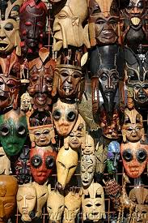
On the left panel of the painting Basquiat has illustrated two Nubian-style masks. The Nubians historically were darker in skin colour, and were considered to be slaves by the Egyptian people
Return to the nile

Slide 13
On the right panel of the painting appear the words “Esclave, Slave, Esclave”. Two letters of the word "Nile" are crossed out and Frohne suggests that, "The letters that are wiped out and scribbled over perhaps reflect the acts of historians who have conveniently forgotten that Egyptians were black and blacks were enslaved."
Return to the nile

Slide 14
“Basquiat has identified the boat in the [painting with the word SICKLE – as an act of labelling, as a reference to the life and migration of ancient Africa, to the tool of manual labour, and to the sickel-cell anaemia which affects contemporary blacks." (Richard D. Marshall in Enrico Navarra et al, Jean Michel Basquiat, Paris, 2000
Return to the nile

Slide 15
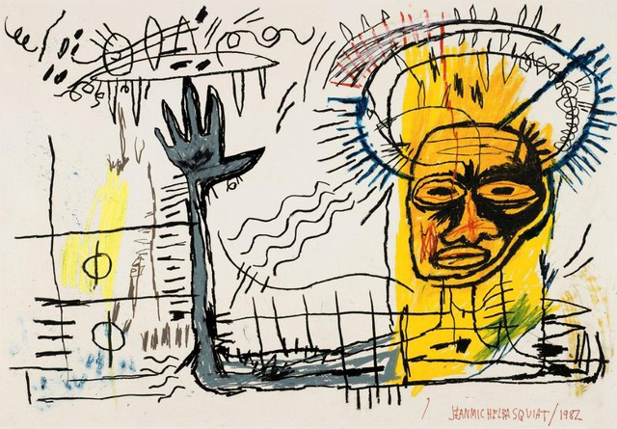
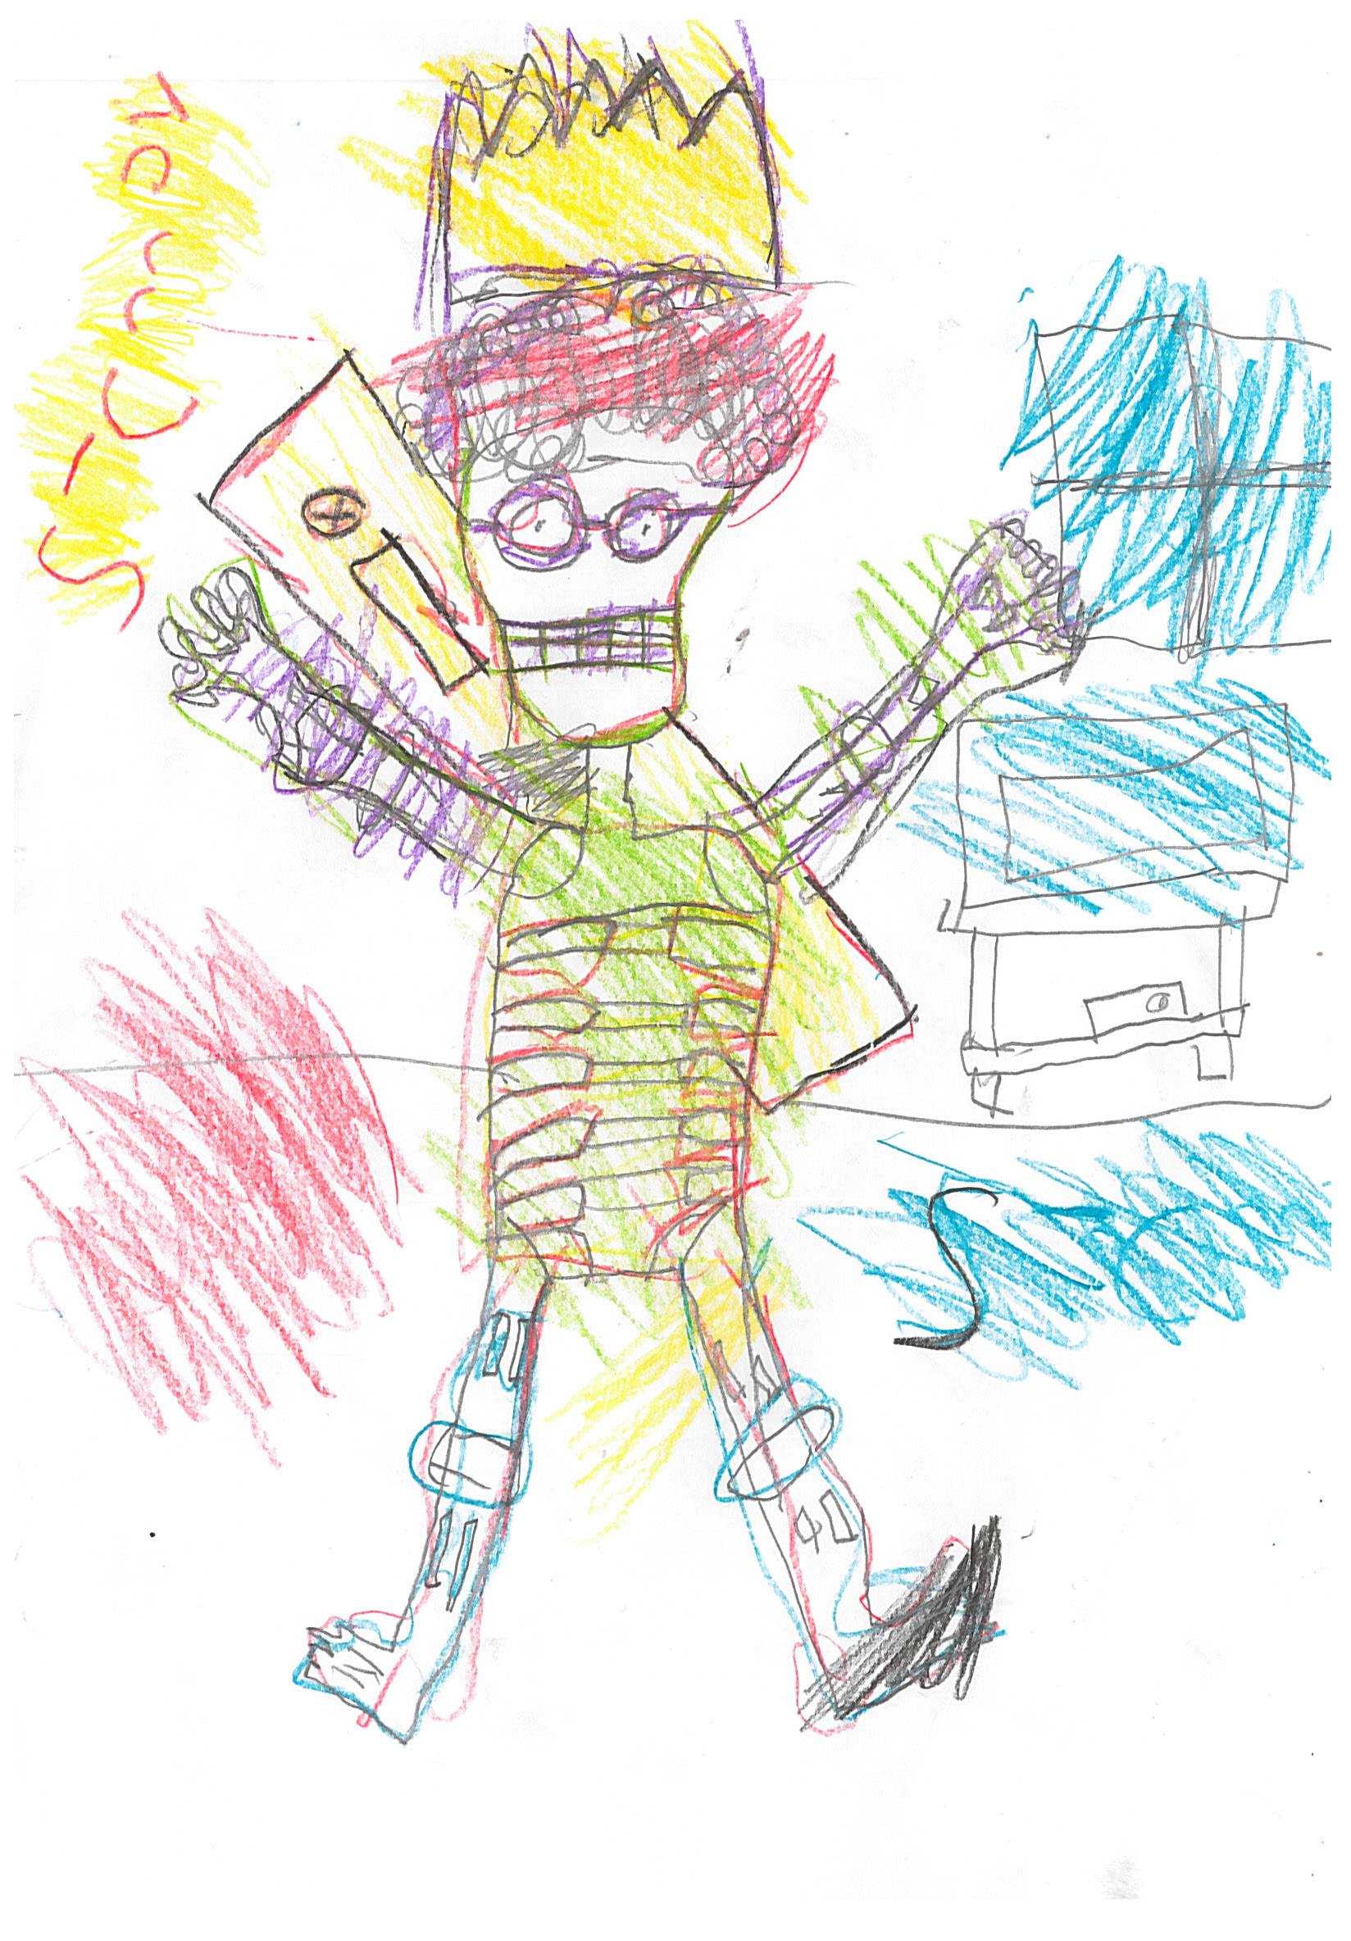
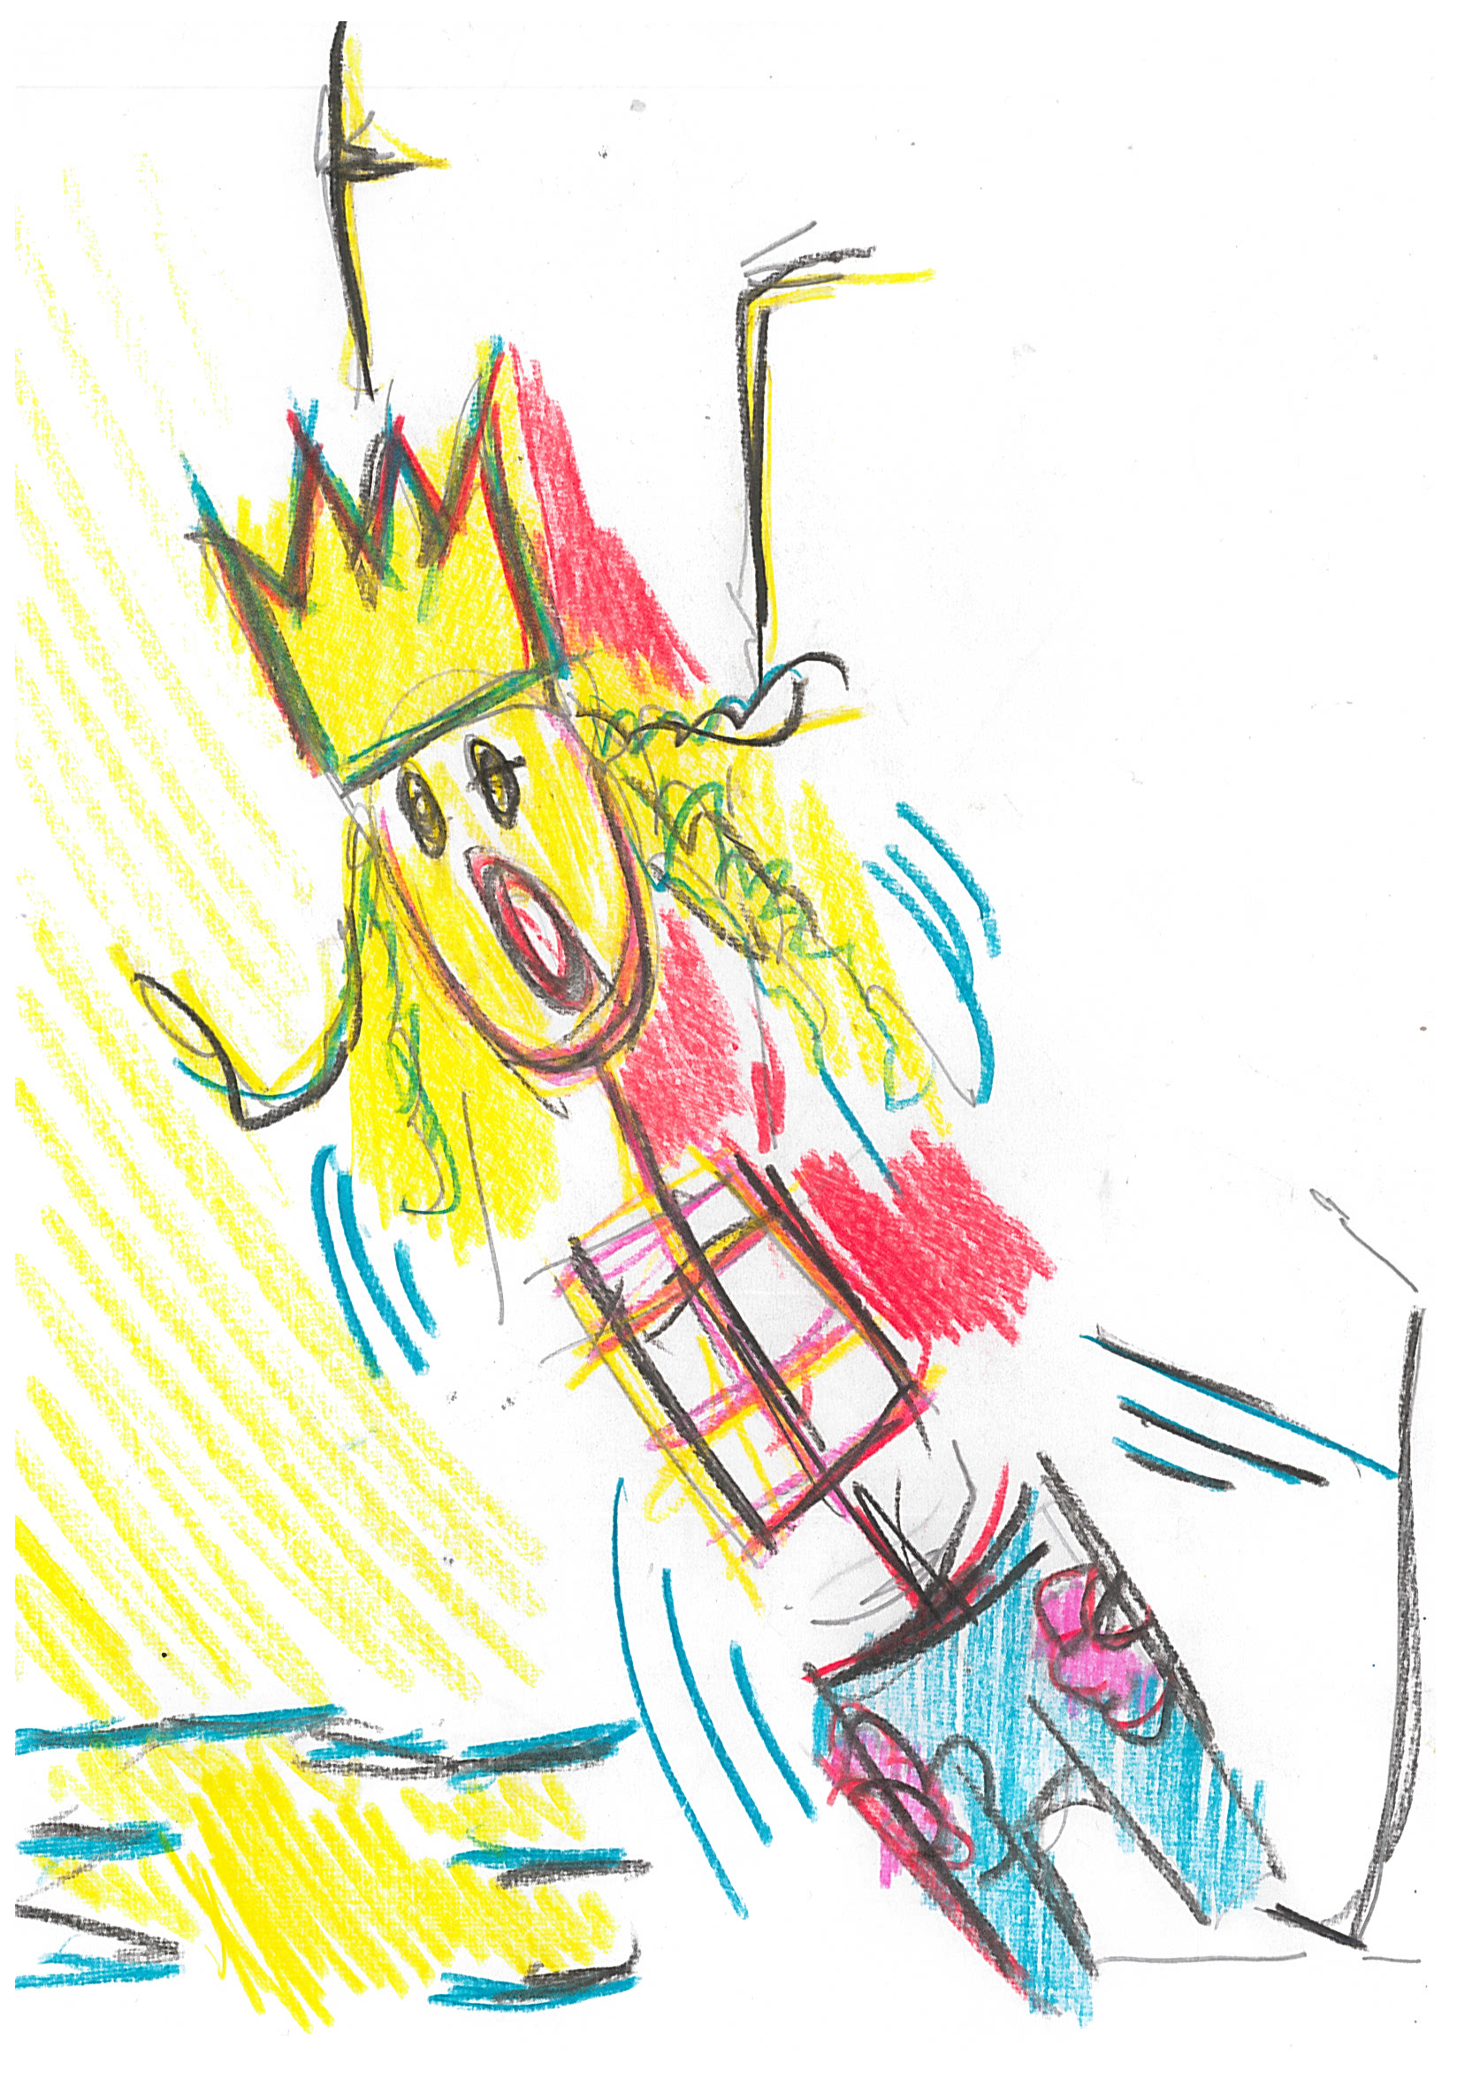

Slide 16
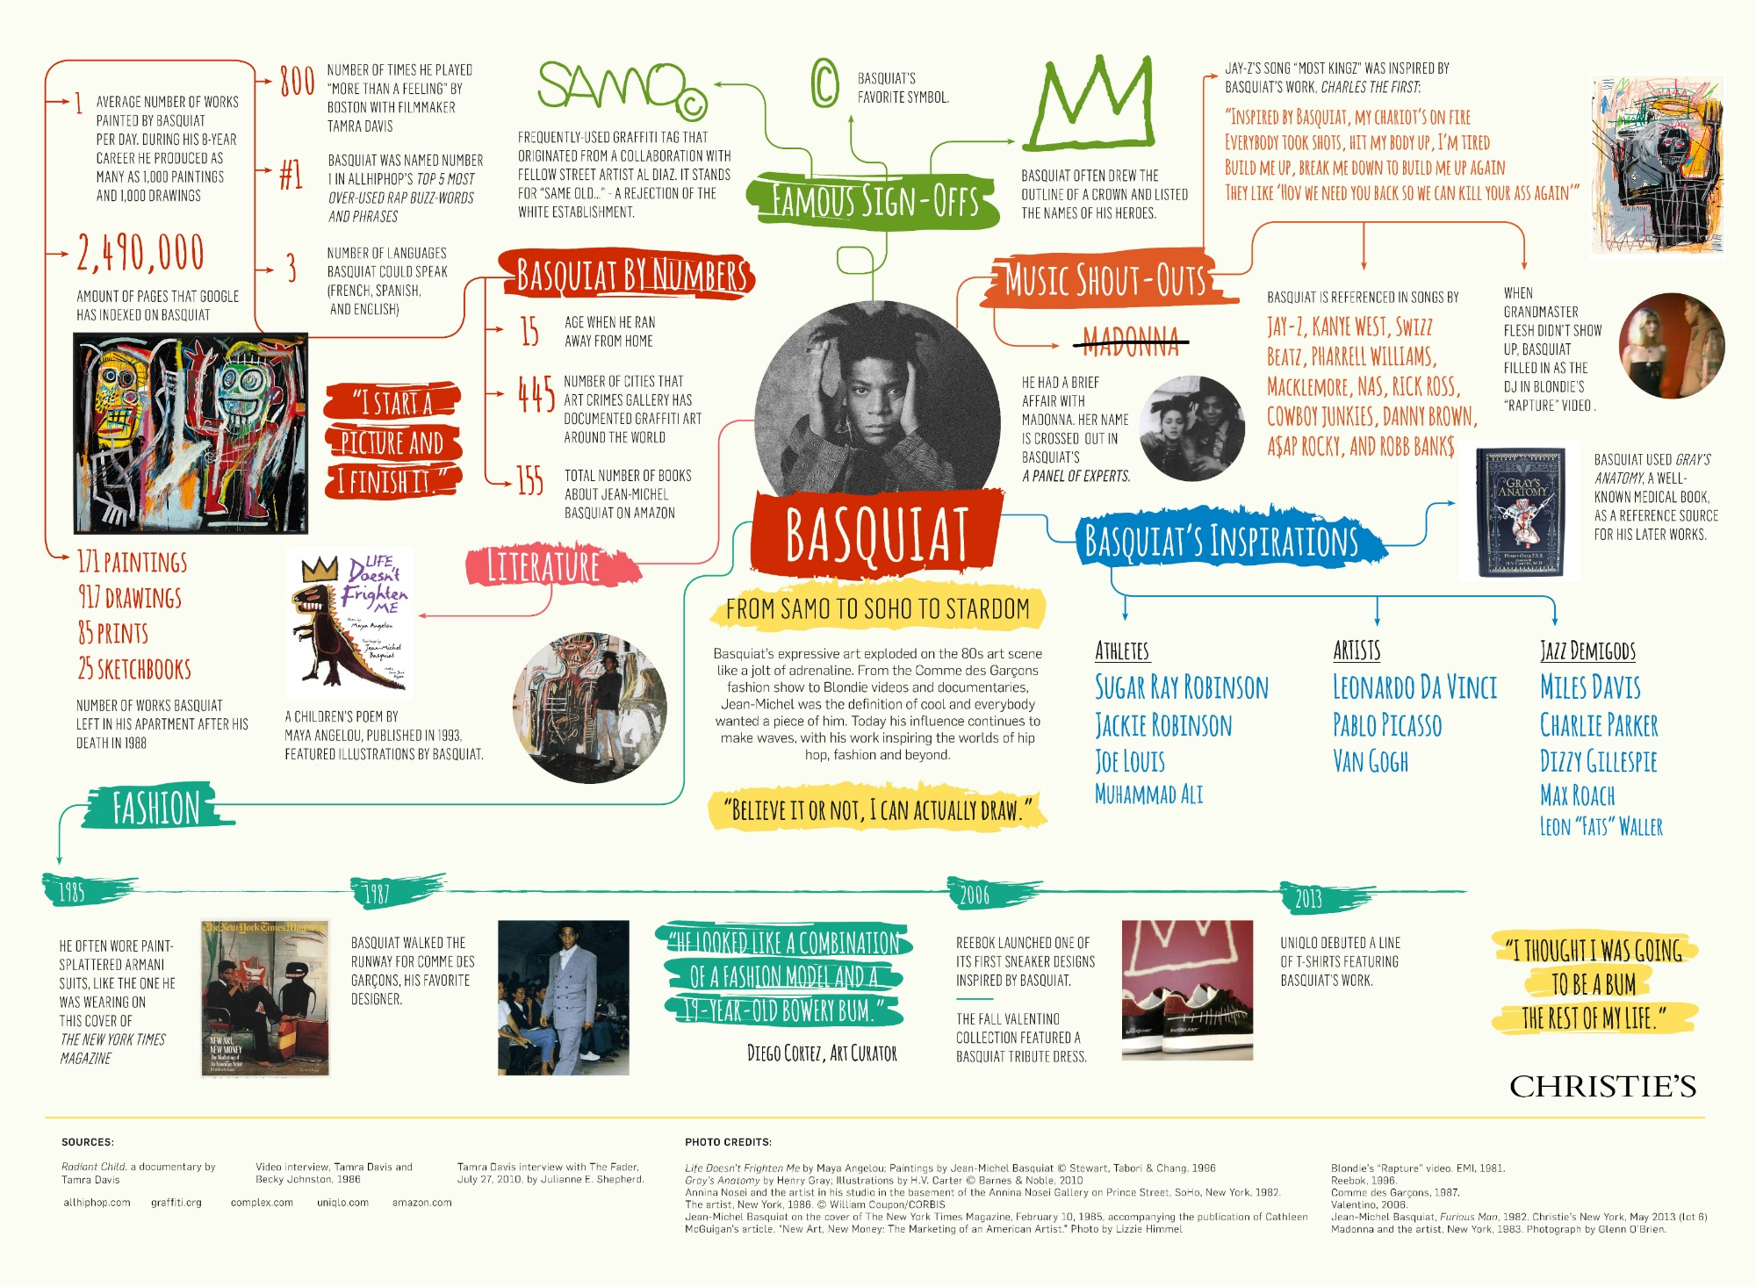

Slide 17
