Slide 1
composition
What is it ? Recap
Moving forward.

Slide 2
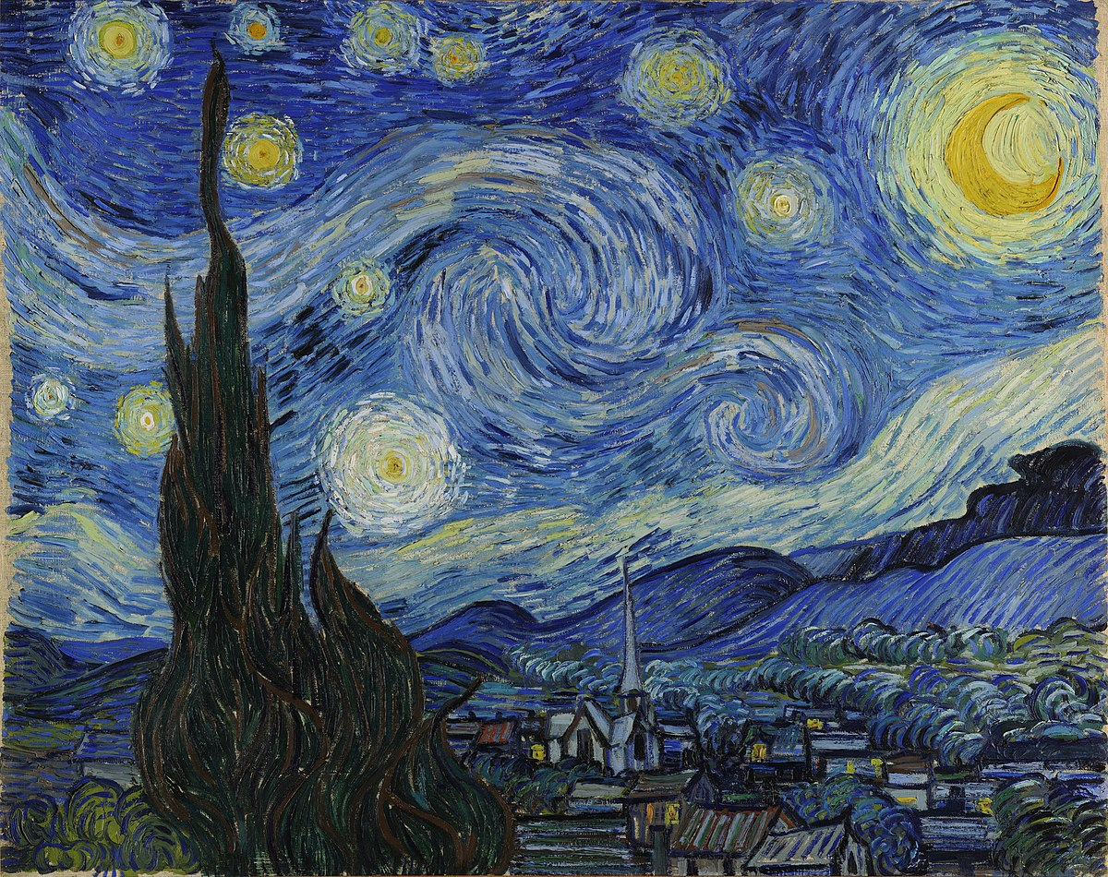

Slide 3
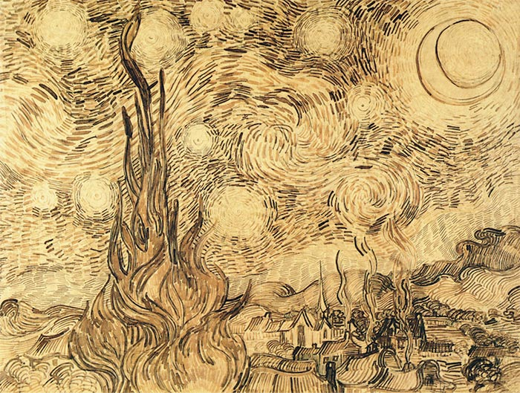
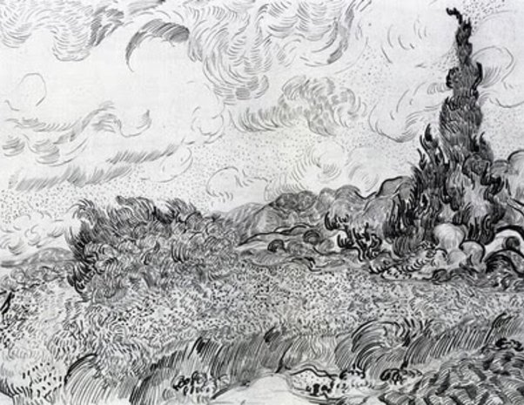

Slide 6
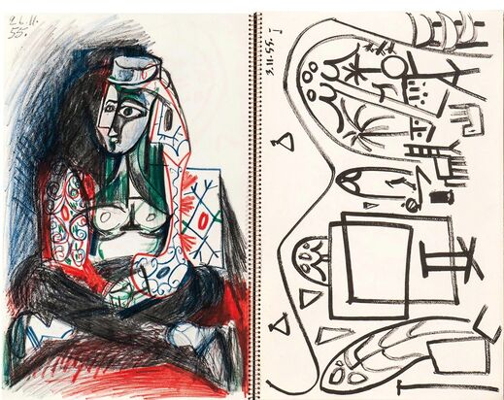
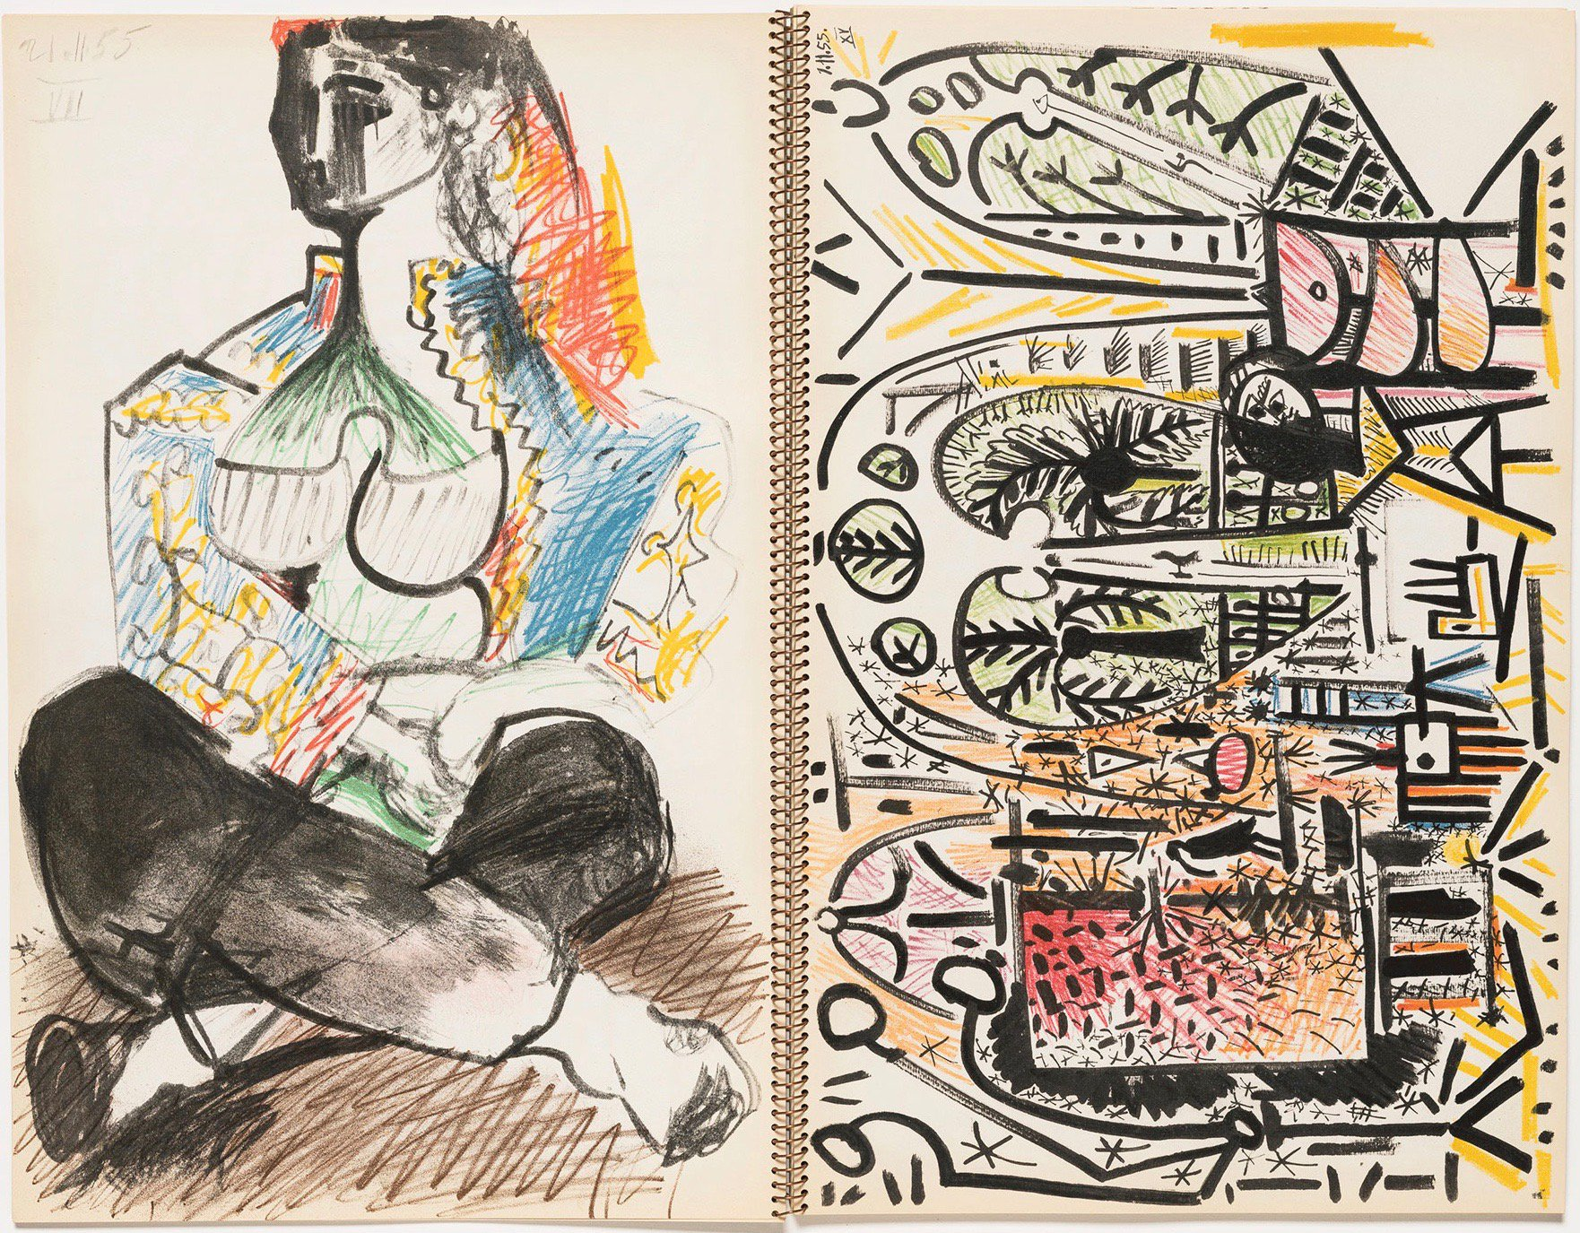

Slide 7
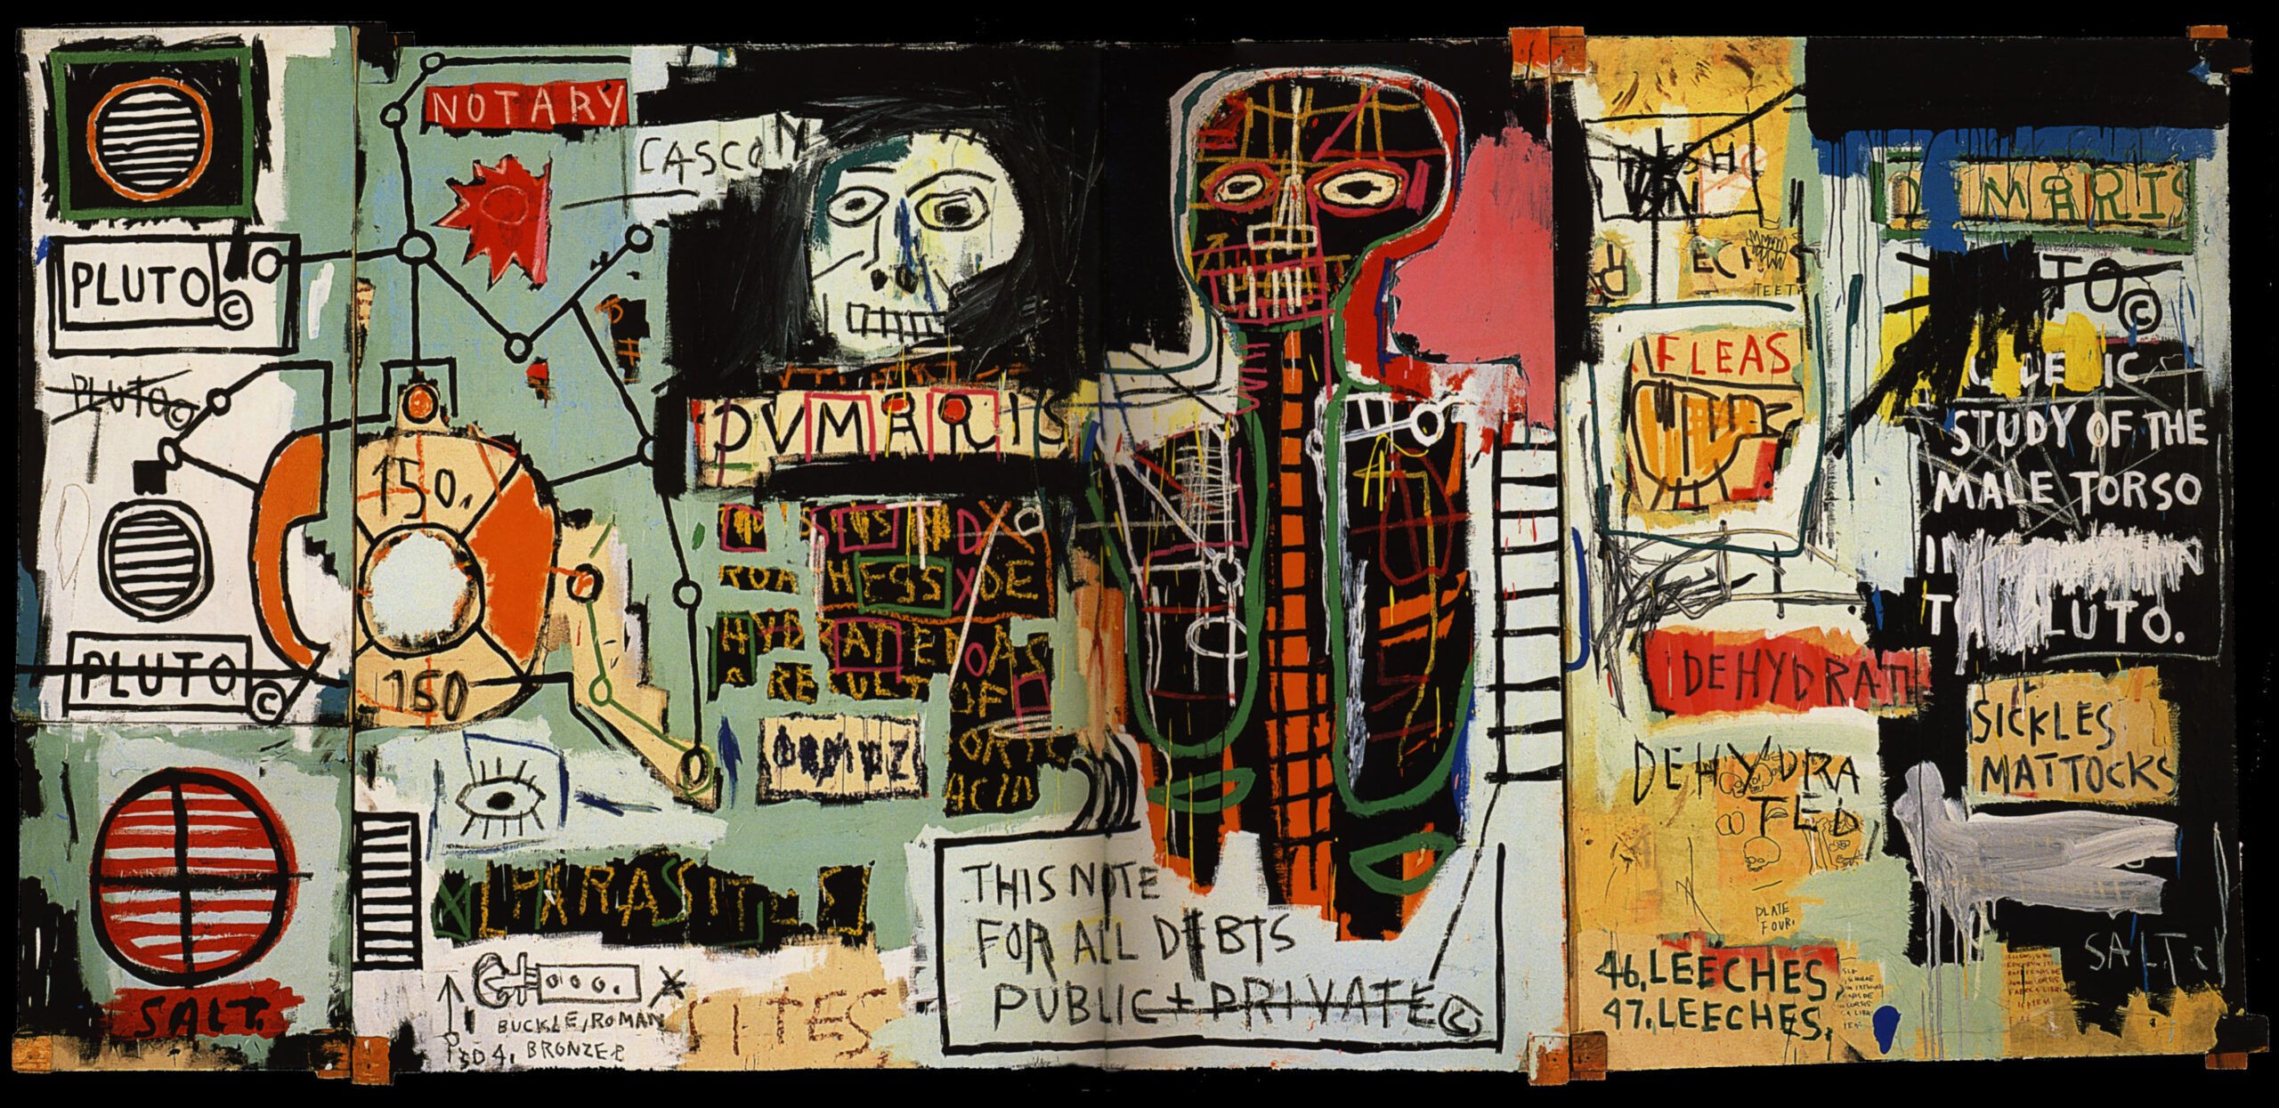
Hundertwasser v Basquiat

Slide 8
How are they different ?
1
2
3
4
5

Slide 9
Which do you think is more personal ?
Why?

Slide 10
Teachers thoughts
Hundertwasser’s painting looks more planned
Colour is carefully constructed
Basquiat painting seems more spontaneous looks like he's making it up as he goes along
Freestyling like the music he likes- Jazz
More to unpick a visual puzzle
BASQUIATS work talks to me ………….. Asks more of me more to think about…..

Slide 11
So what next ?
Develop your drawing style
Develop your understanding of Basquiat's compositional style

Slide 12
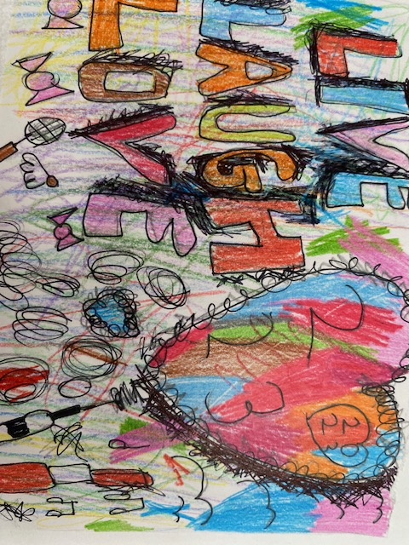
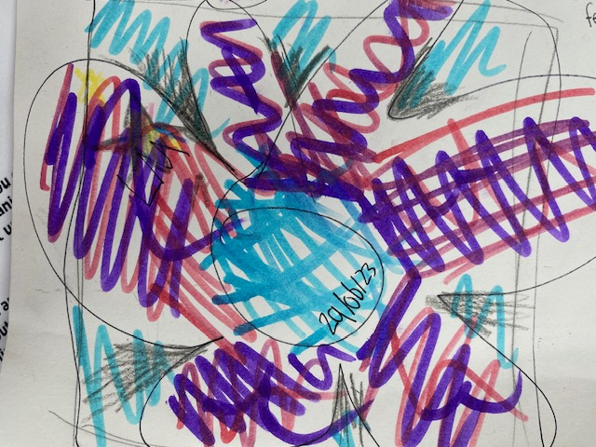
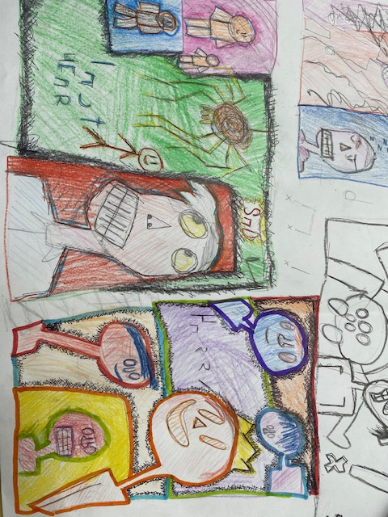
So what next ?
Develop your drawing style
Develop your understanding of Basquiat's compositional style

