Slide 1
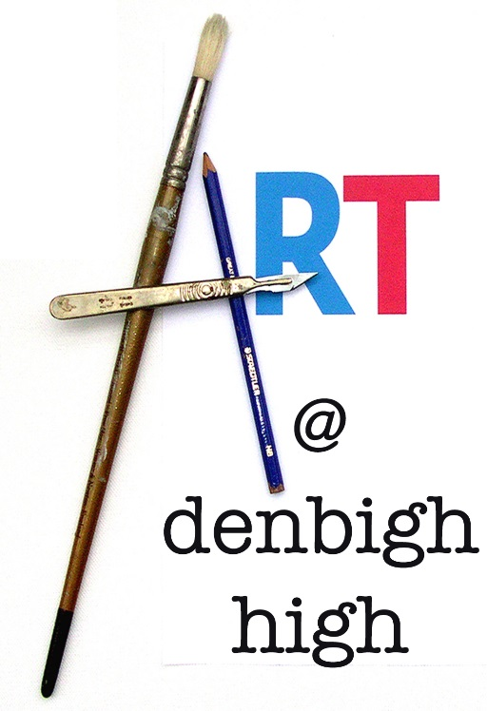
Why choose art ?

Slide 2
Why choose GCSE Art and Design? If you enjoy being creative, want to increase your practical skills and improve your analytical, communication and research abilities, art and design is a great choice. The skills you gain make it a great complement to other subjects. Art and design is a way of seeing things and making sense of the world around you. It can help you with further study and prepare you for the world of work.

Slide 3
The importance of creativity
Sir Ken Robinson:
Creativity Is In Everything,
It’s sometimes said that creativity cannot be defined. I think it can. Here’s my definition,
: Creativity is the process of having original ideas that have value.

Slide 4
The economic contribution of the creative industries is well known. What is less well understood is the impact that arts subjects have on developing resilience, tolerance, empathy and emotional intelligence. Amidst growing concern about the wellbeing of young people, one of the most revealing aspects of the research was the consistency with which young people told us that arts lessons are the only place where they feel able to explore and express their own thoughts, opinions and ideas. With no definitive right or wrong answers, arts subjects allow young people the freedom to develop their own identities and explore alternative ideas, approaches and other points of view, as well as how to articulate arguments of their own. Often referred to as "soft" skills, these are arguably some of the most important tools in any young person’s armoury, preparing them for life beyond school and encouraging them to contribute to their communities as well as to the wider world.
By Jacqui O’Hanlon education officer rsc
16 October 2018

Slide 5
The CBI's (Confederation of British Industry's) say……..
CREATIVE INDUSTRIES
JOIN THE CBI
From film and television, to advertising and marketing, the creative industries are one of the UK’s fastest growing sectors in terms of both job and value creation. Alongside their vital economic role, these industries help mould the UK’s global brand, shaping investment, tourism, and our cultural influence. The UK’s reputation as a leader in the creative industries means that we are in a formidable position to take advantage of international opportunities, and the CBI supports the sector to do just that.

Slide 6
What will you study?
Fine art Fine art explores ideas, conveys experiences or responds to a theme or issue of personal significance. The areas of study are very broad and cover drawing, painting, sculpture, installation and mixed media.

Slide 7
What will you study?
Fine art Fine art explores ideas, conveys experiences or responds to a theme or issue of personal significance. The areas of study are very broad and cover drawing, painting, sculpture, installation and mixed media.

Slide 8
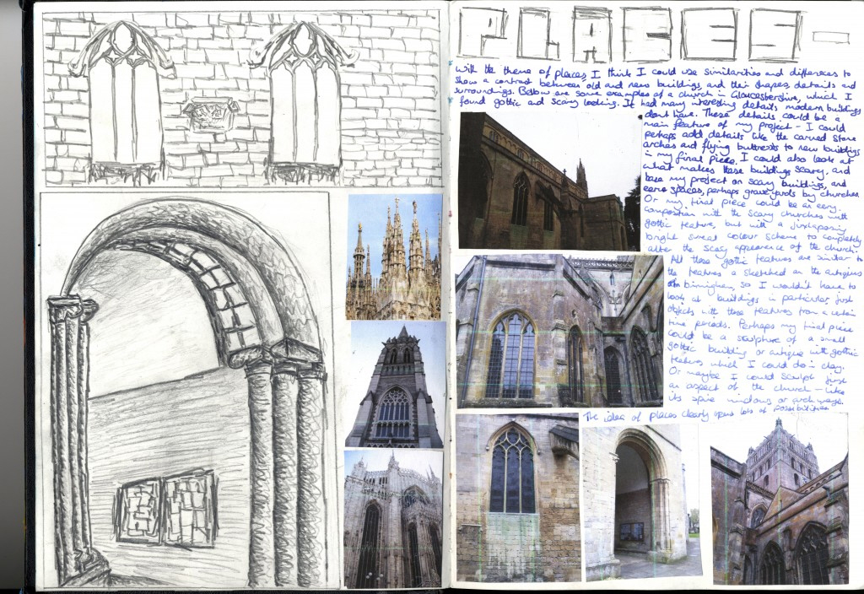

Slide 10
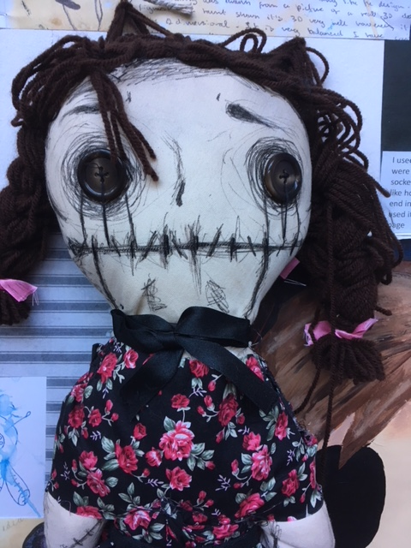
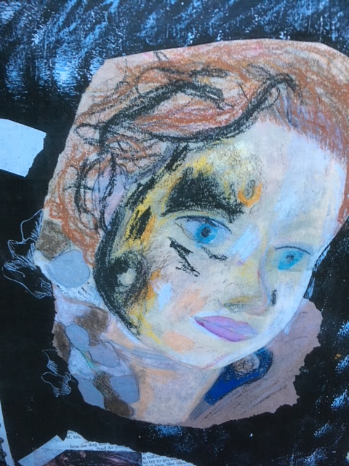
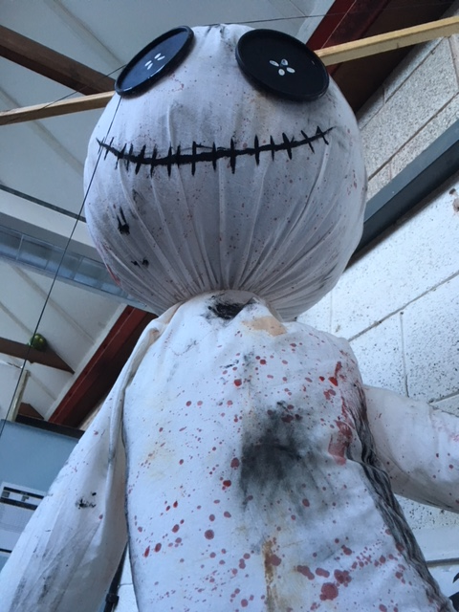

Slide 11
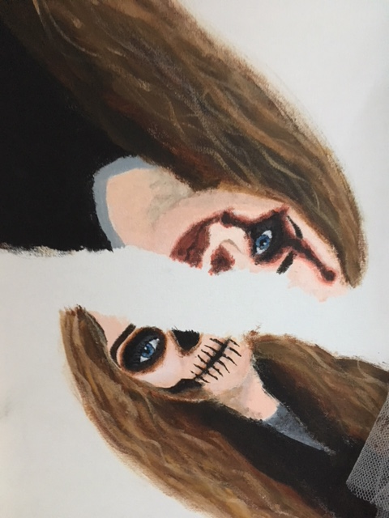

Slide 12
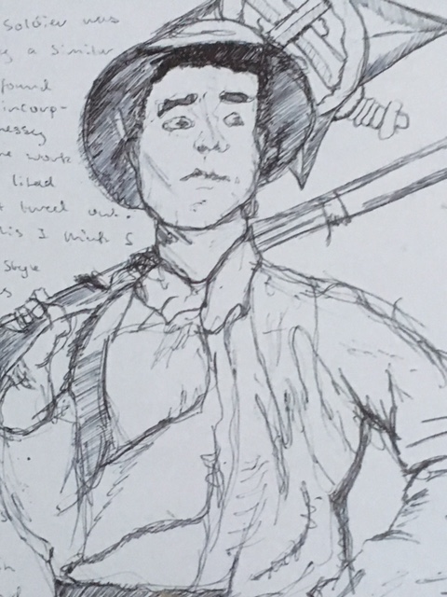
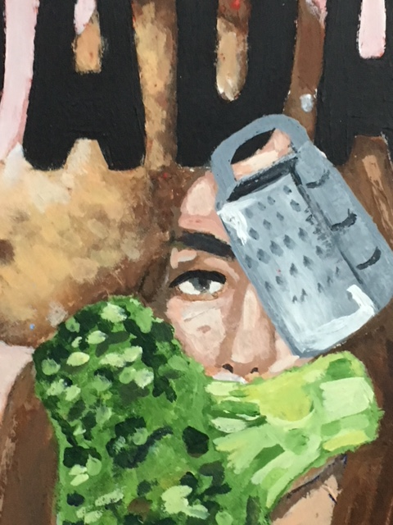

Slide 13
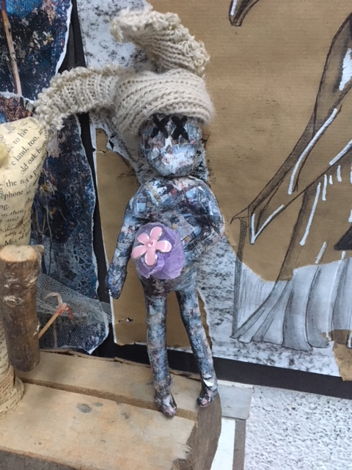
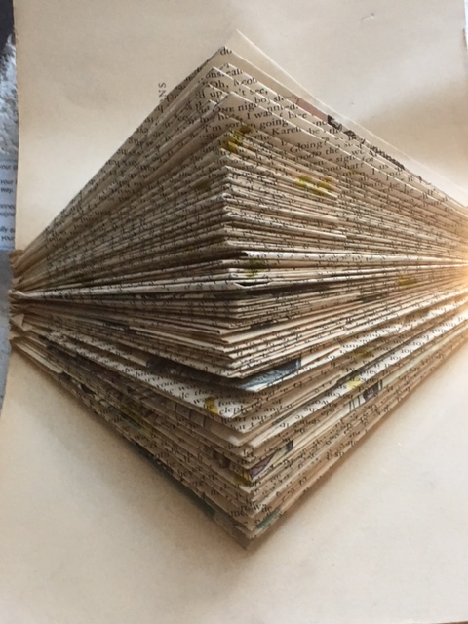

Slide 14
https://vimeo.com/266680534
https://vimeo.com/209359053

Slide 16
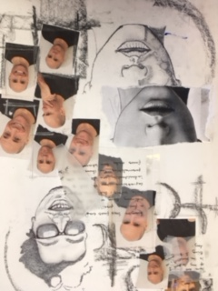
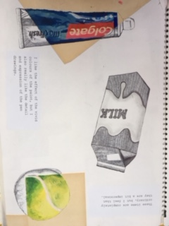

Slide 17
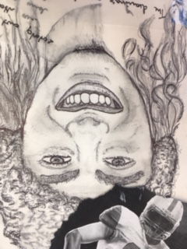

Slide 18
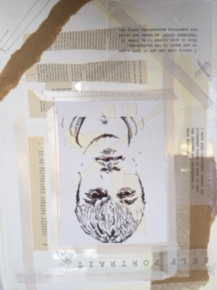
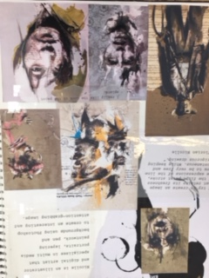

Slide 19
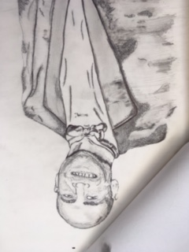
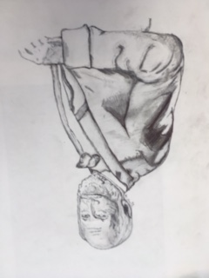

Slide 22
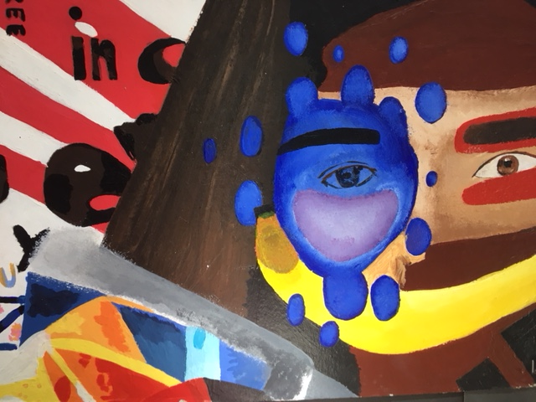

Slide 24
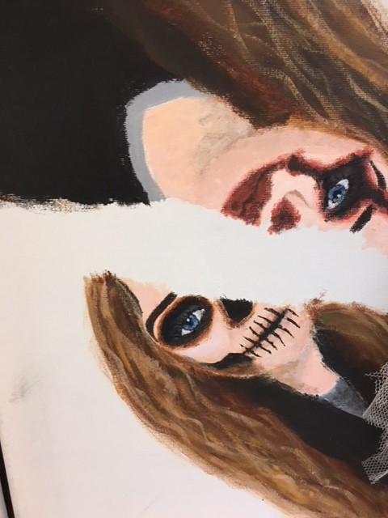

Slide 25
List of 60 Art Careers
If you think there are only a few options for careers in the art field, you'll be pleasantly surprised that there are dozens of choices. Here are 60 of the most popular career options for people who want to work as artists or in an occupation related to art and design.
Creative director
Courtroom artist
Display designer
Estate appraiser
Exhibit installer
Fashion designer
Film production
Furniture designer
Glass blower
Graphic designer
Layout artist
Illustrator
Industrial designer
Interior designer
Landscape designer
Logo designer
Makeup artist
Multimedia artist
Museum archivist
Museum curator
Museum manager
Painter
Photographer
Photojournalist
Police sketch artist
Portrait artist
Set designer
Sketch artist
Tattoo artist
Television production
Videographer
Visual merchandiser
Web designer
Acquisitions specialist
Advertiser
Animator
Antique appraiser
Antiques refinisher
Architectural designer
Art appraiser
Art auctioneer
Art director
Art gallery curator
Art gallery owner
Art gallery manager
Art historian
Art investor
Art librarian
Art professor
Art reviewer
Art teacher
Art therapist
Artists' agent
Arts organization fundraiser
Caricature artist
Cartoonist
Commercial artist
Corporate communication specialist
Costume designer
Craftsperson

