Slide 1
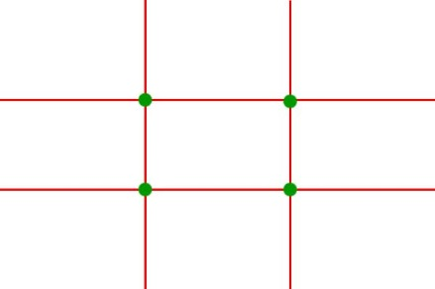
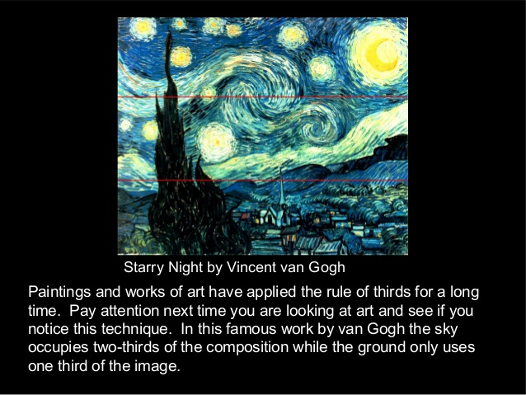
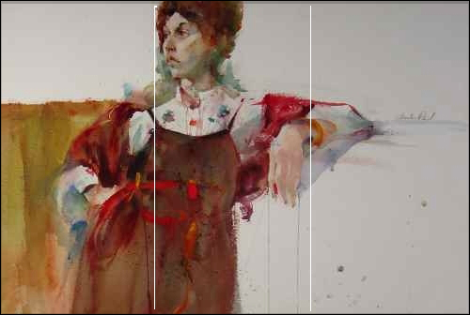
THE GOLDEN SECTION
TheRuleofThirdsis actually a guideline more than arule. It is intended to help theartistthe placement of the elements and focal point within the composition. But, if you want your viewer to ignore the other parts of your painting, then go ahead break aruleand center your subject like a big bull's-eye!
Both the woman’s head AND her drooping hand are located within the center section of the rectangle. . . yet her face is looking toward the left edge of the painting while her elbow is pointing toward the right.
Those last two factors (combined with the dark square shape on the lower left) result in a psh/pull composition that leads the viewer’s eyes back and forth through power points of the rule of thirds, thereby keeping the viewer’s attention fully engaged.
TheRuleThirds The Golden Section

Slide 2
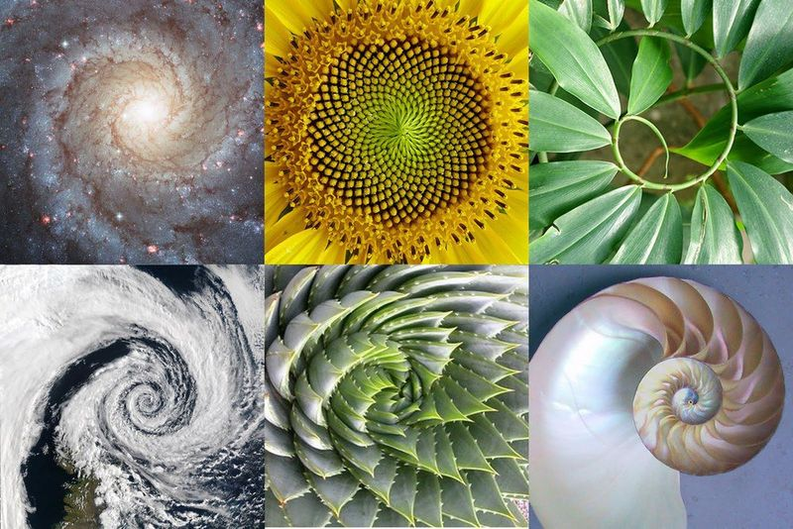
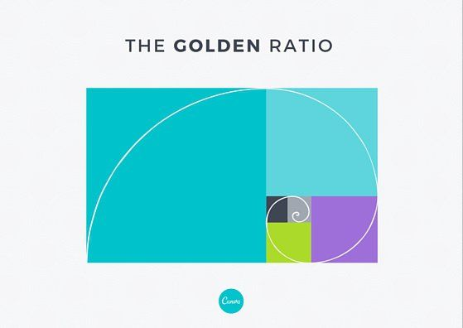
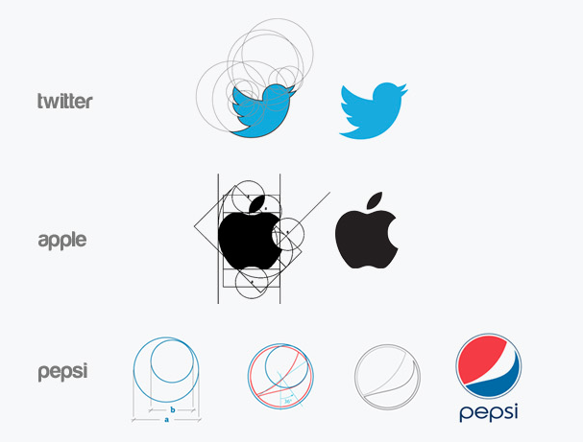
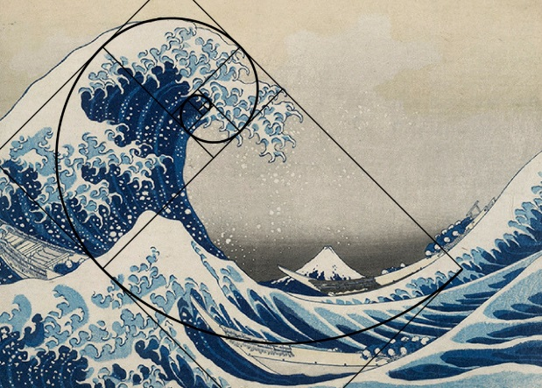
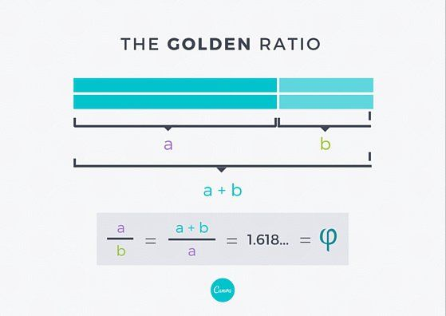
THE GOLDEN SECTION
What do the Pyramids of Giza and Da Vinci’s Mona Lisa have in common with Twitter and Pepsi?
Quick answer? They are all designed using the Golden Ratio.
The Golden Ratio is a mathematical ratio. It is commonly found in nature, and when used in design, it fosters organic and natural looking compositions that are aesthetically pleasing to the eye. But what exactly is the Golden Ratio and how can you use it to improve your own designs?
What is the Golden Ratio?
Putting it as simply as we can (eek!), the Golden Ratio (also known as the Golden Section, Golden Mean, Divine Proportion or Greek letter Phi) exists when adivided into two parts and the longer part (a) divided by the smaller part (b) is equal to the sum of (a) + (b) divided by (a), which both equal 1.618.
But don’t let all the math get you down. In design, the Golden Ratio boils down to aesthetics— creating and appreciating a sense of beauty through harmony and proportion. When applied to design, the Golden Ratio provides a sense of artistry; an X-factor; a certainje ne sais quoi.

Slide 3
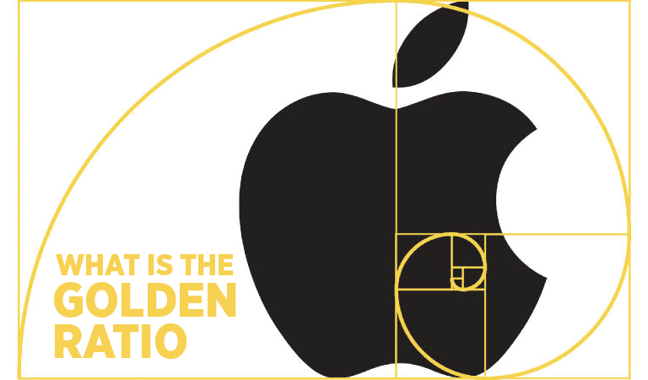
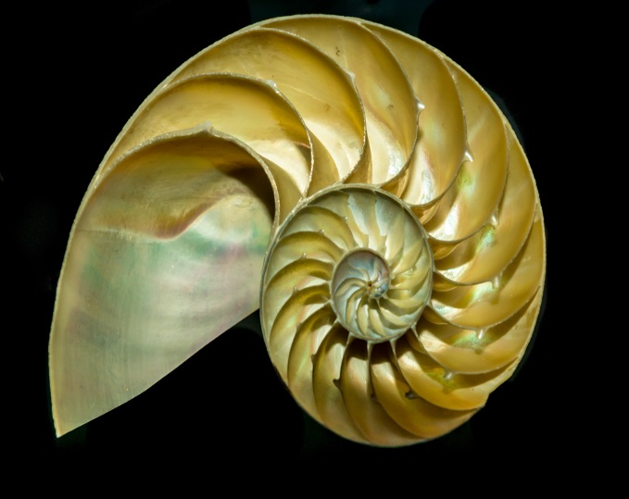
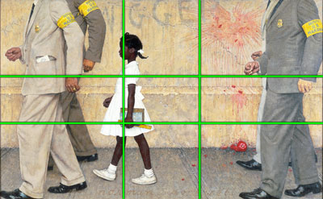
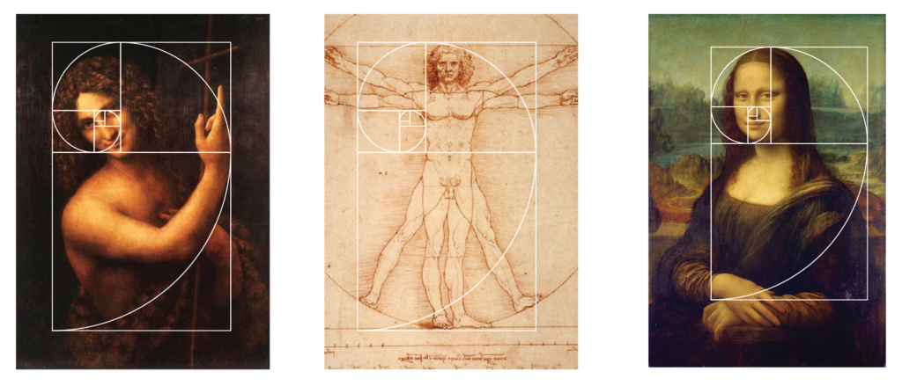
THE GOLDEN SECTION

Slide 4
THE GOLDEN SECTION
The task produce a 4 page booklet in publisher that shows an exploration of both the The Rule of Thirds & The Golden Section ask you teacher how to do this .
Remember to write in your own words as a copy and paste approach teaches you nothing !
You will be asked to develop a composition using your knowledge of the work completed in you sketch book and in this task.

