Slide 1
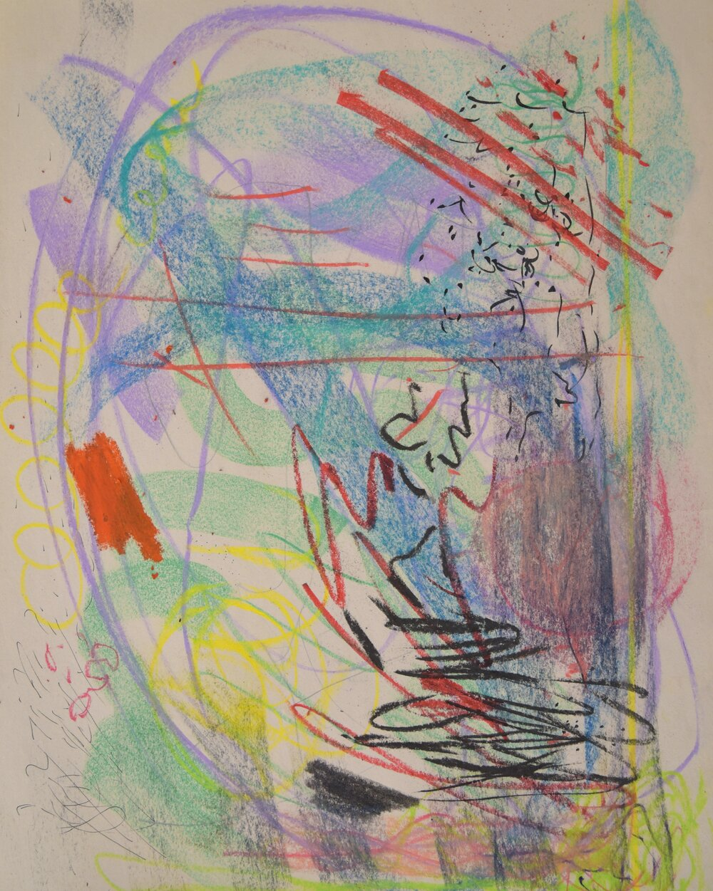
Comparing and contrasting
Basic Better Best

Slide 2
https://www.youtube.com/watch?v=V8cXTHz_o2o

Slide 3
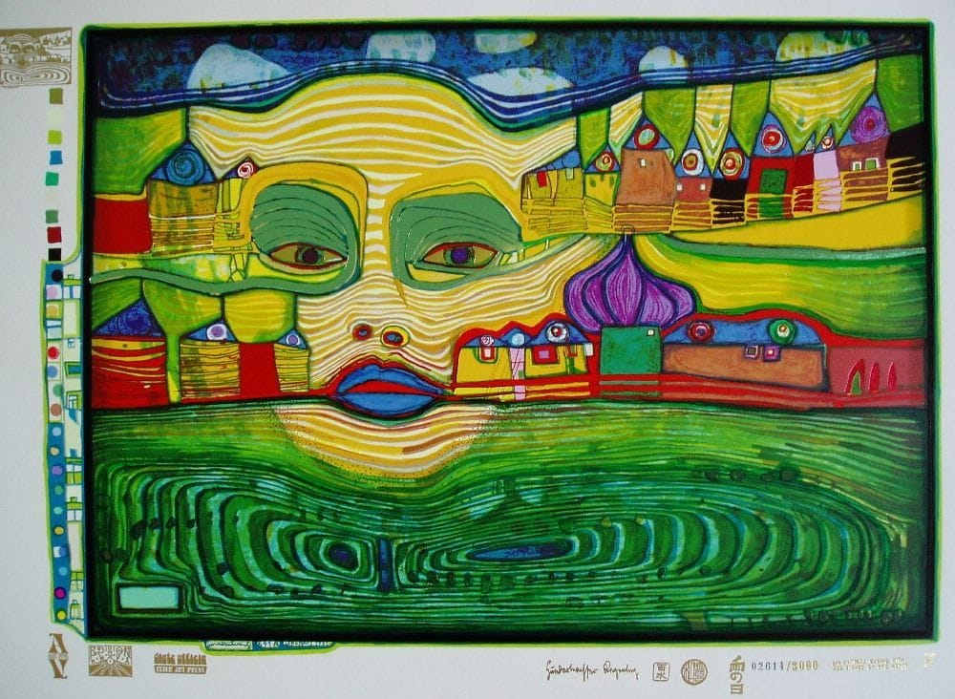
Types of anotation
Basic
Better
Best

Slide 4
Basic
I can see a ………………………………….
Face
House
Grass clouds patterns
Sky
Lips ,nose eyes
Houses lines

Slide 5
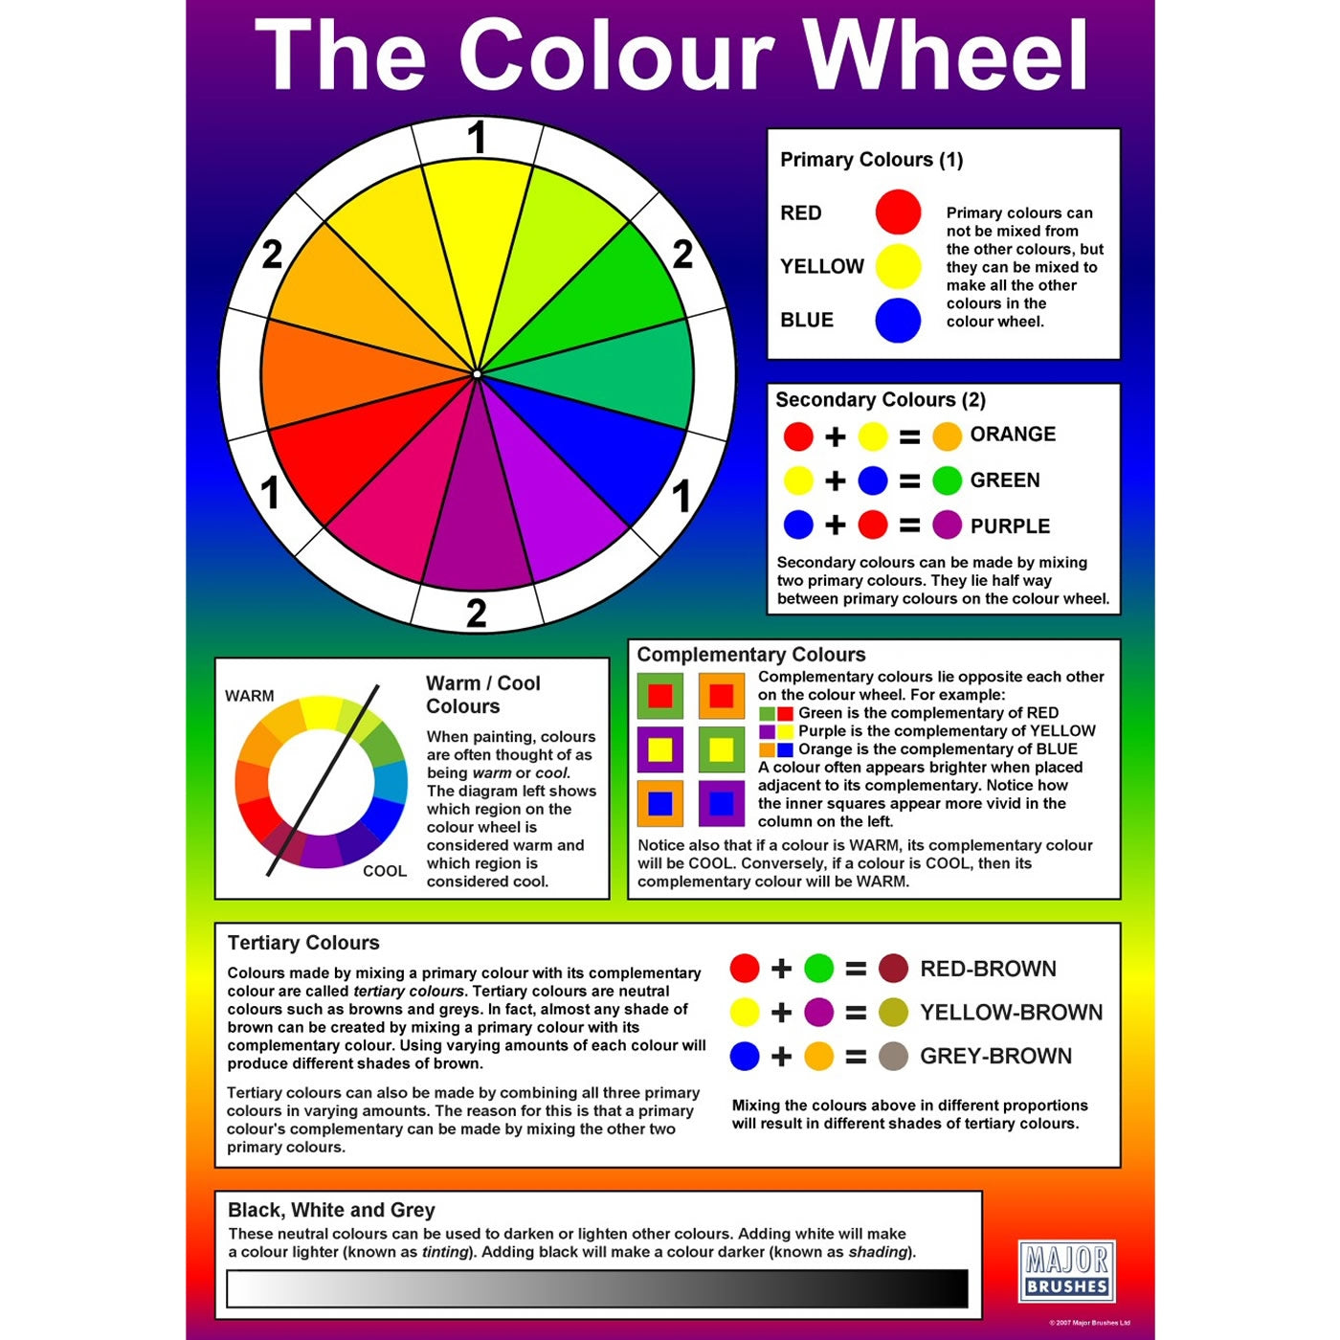
Better
I can see a ……………..
It has been…………..
The artist has used colour…….
The artist has …………………

Slide 6
Best
I can see a ……………..
It has been…………..
The artist has used colour ……………….
I think the artist is saying………………………

