Slide 1
Eve Price Portfolio
Fine Art
Student ID. 1761777367

Slide 2
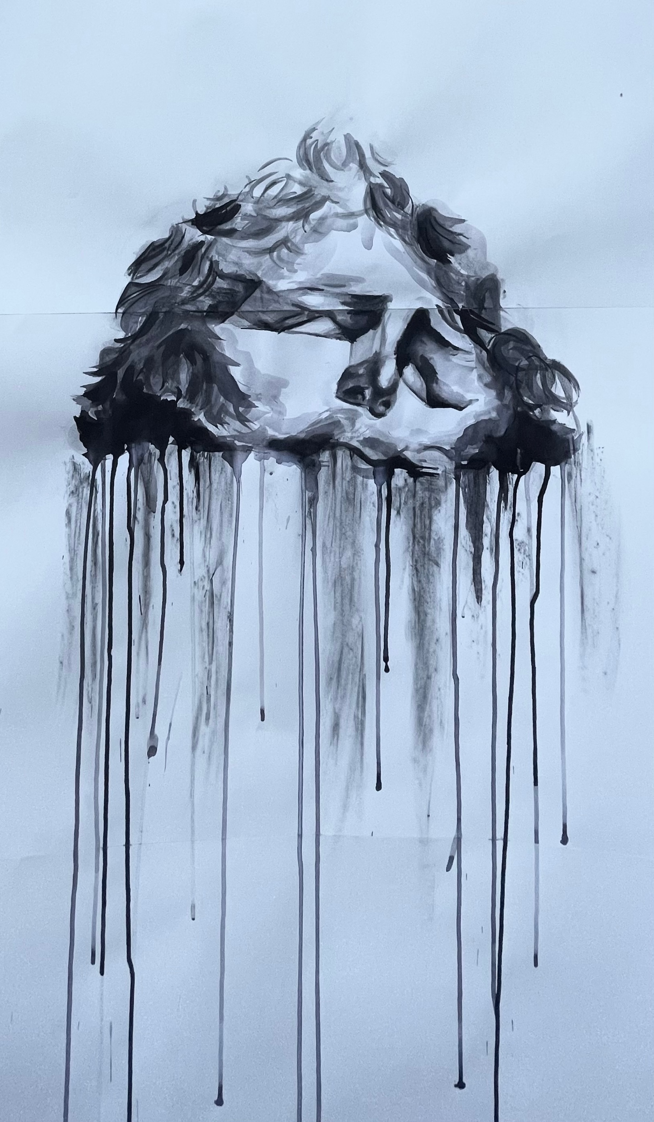
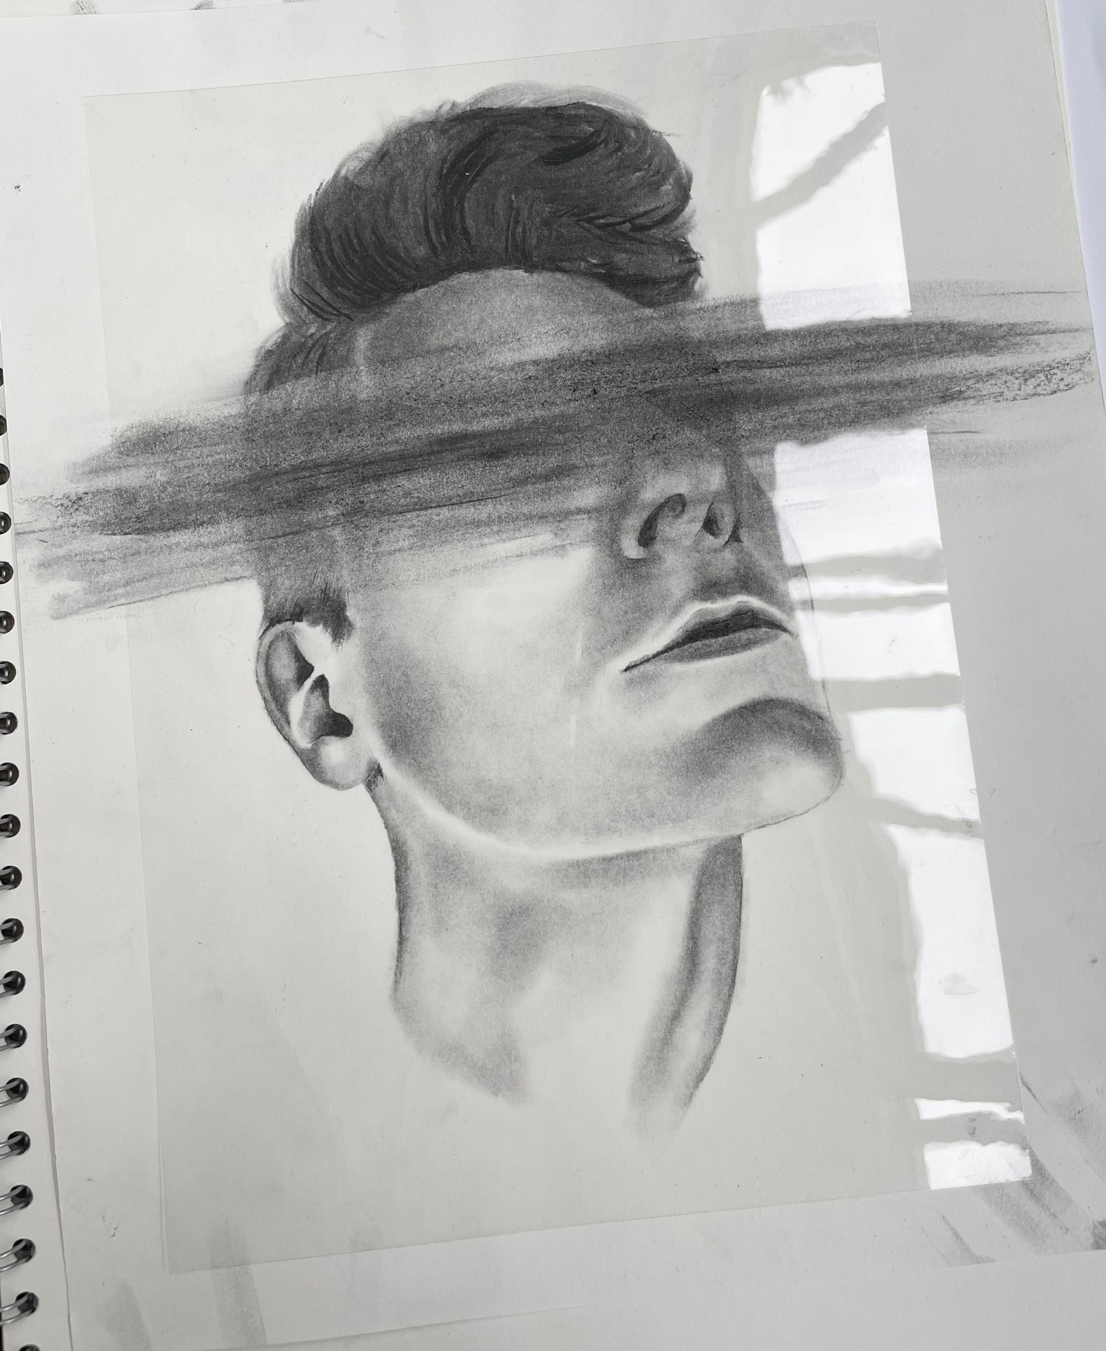
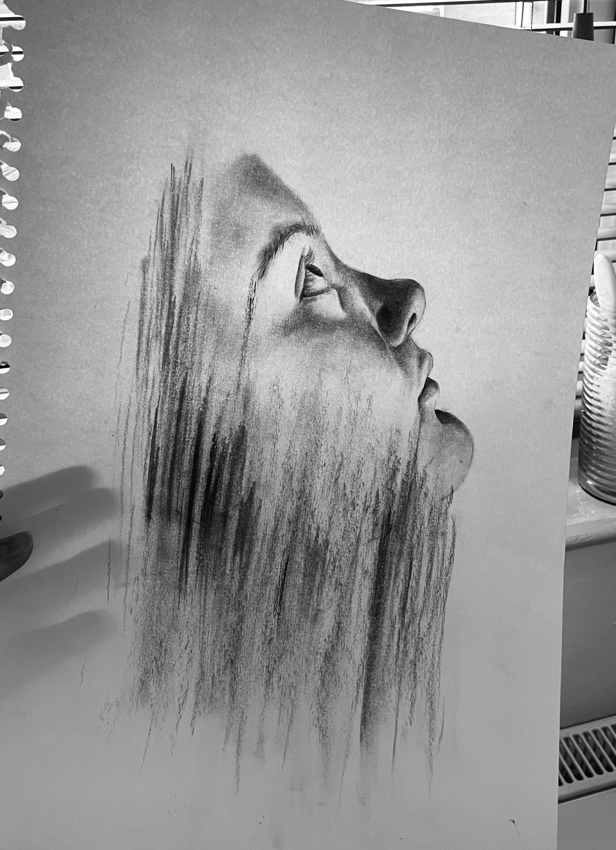
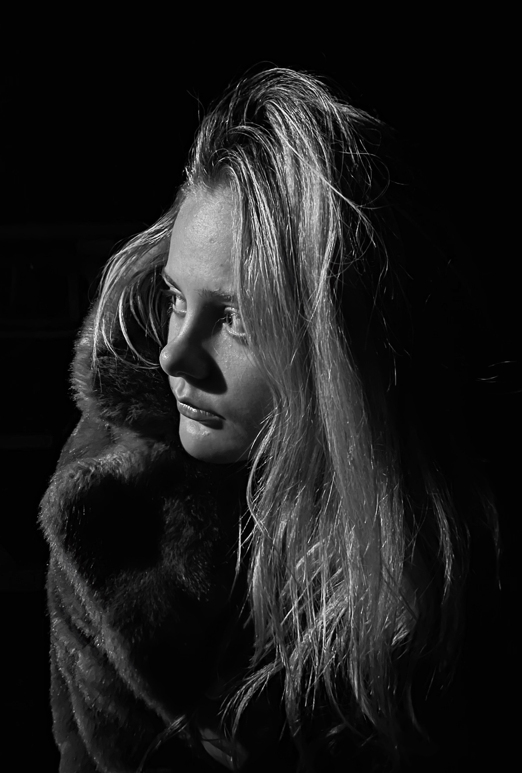
Emotion through figurative media
Expressing human emotion through a range of medias from sketching to photography is something I've practiced thoroughly throughout my art journey. I found this topic is something I can often relate back to. Through this topic, I found my love of charcoal. I discovered how you can build beautiful strong contrasts and achieve high levels of realism through its ability to seamlessly blend. I studied the charcoal artist known as Mad Charcoal who inspired me to create these emotion rich pieces. Each of these pieces reflect emotion and ideas of mental health, with many of my pieces I tend to leave out a section of the image which symbolizes the feeling of losing yourself and feeling as if a piece is missing, this is a feeling many people can relate to and I like to think people can see that within my work. My work is a range of sizes from A4/A3 to 1.5 metres like the image shown on the left.

Slide 3
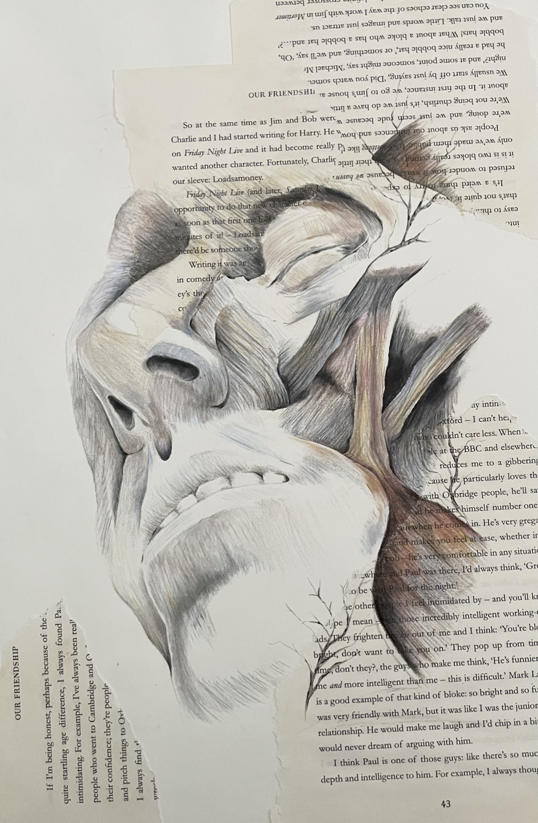
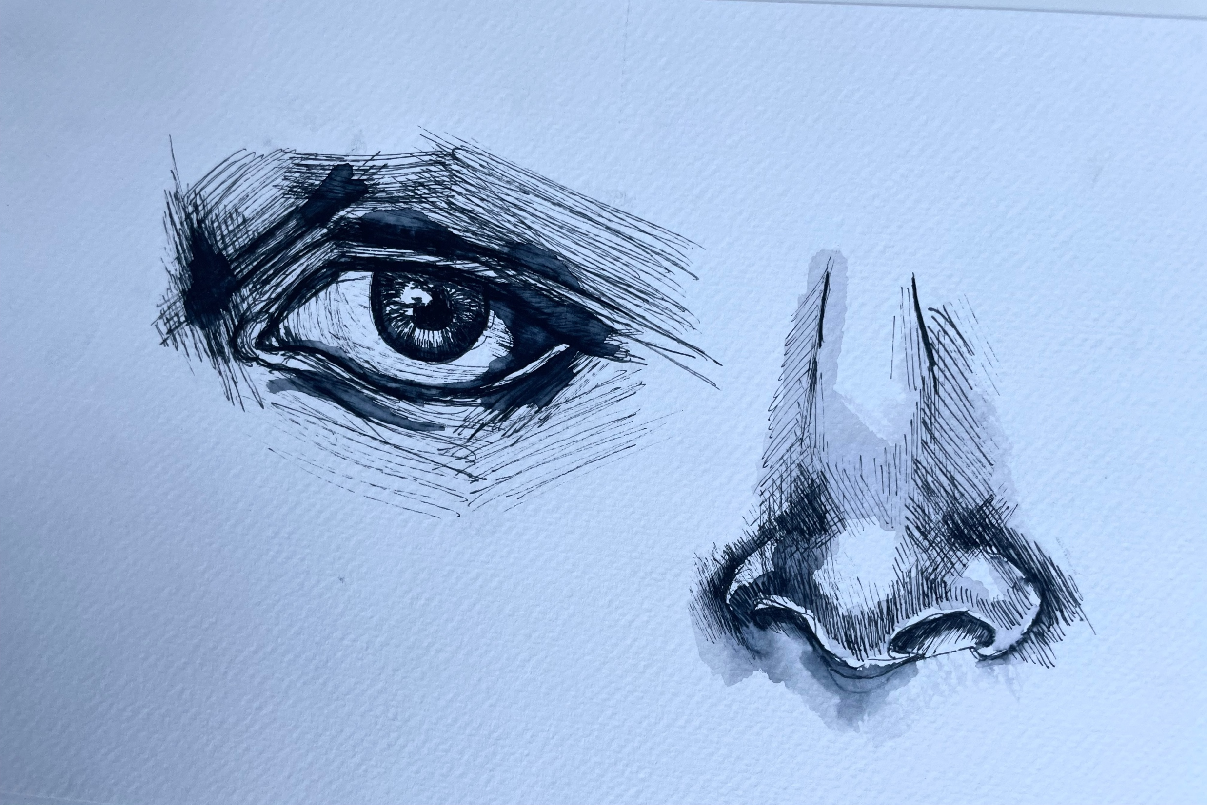
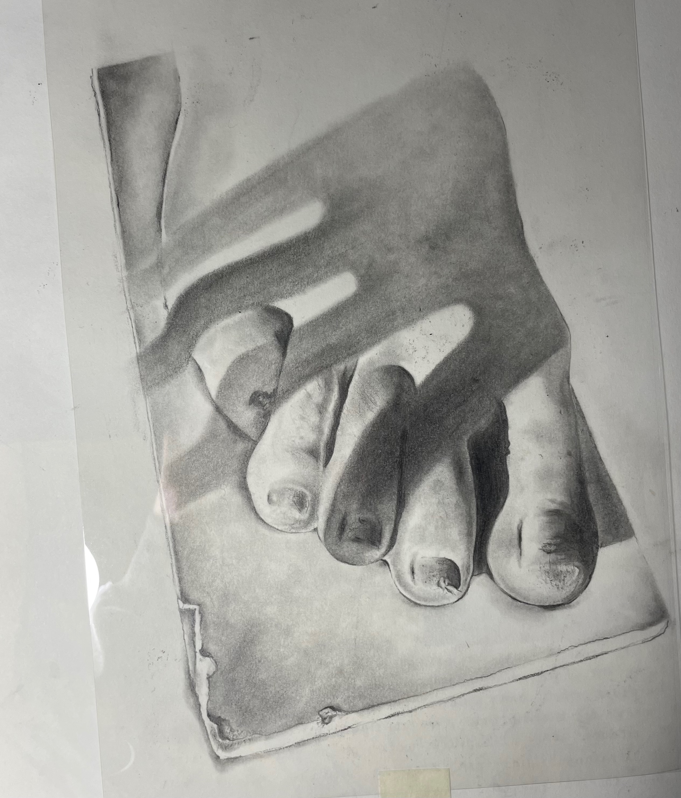
Anatomy
My exploration of human anatomy closely links in with my work on human emotion, here I've explored human structure and muscle. This was a topic that explored both realism and surrealism. I created many outcomes using only coloured pencils to create detailed figurative pieces with inspiration from the artist Nunzio Paci who explores contrast between nature and the human anatomy.

Slide 4
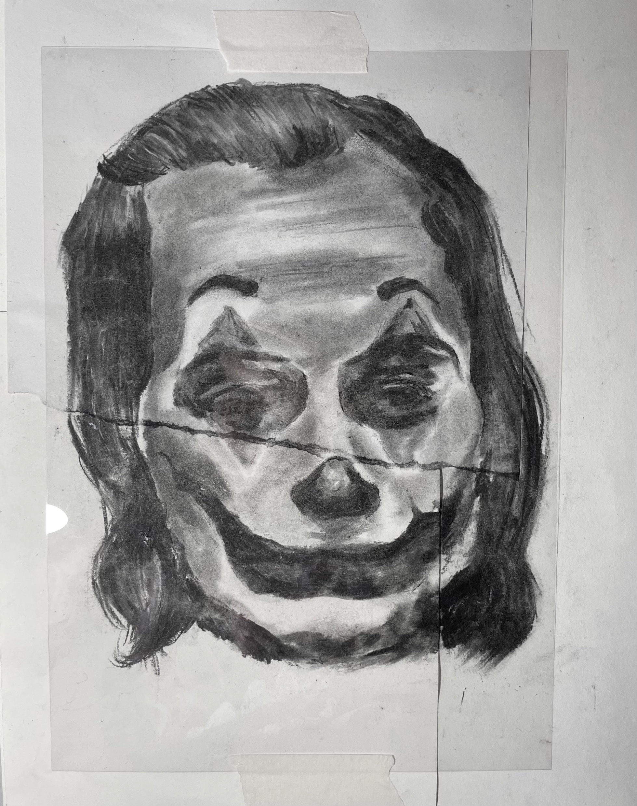
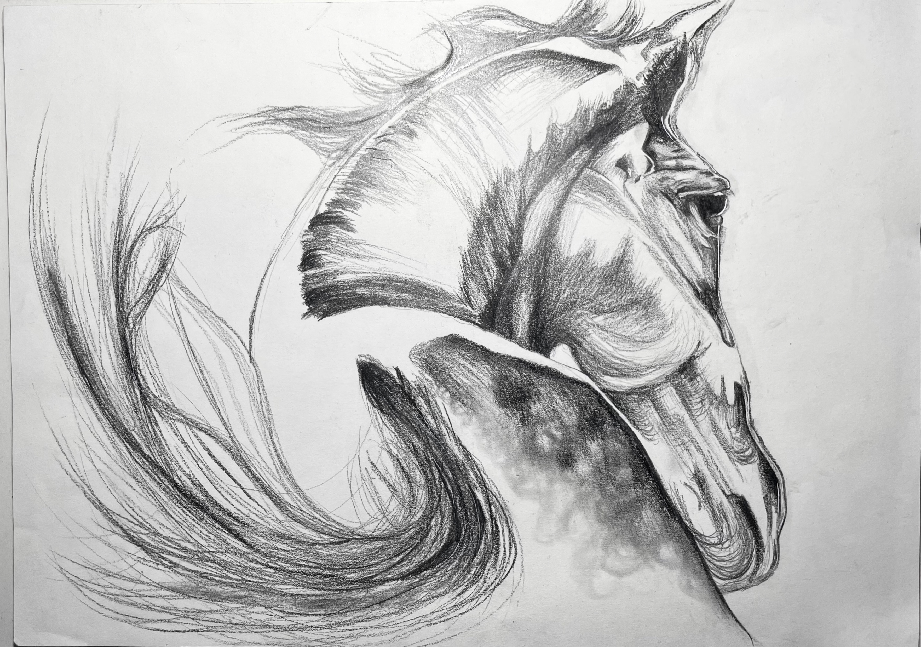
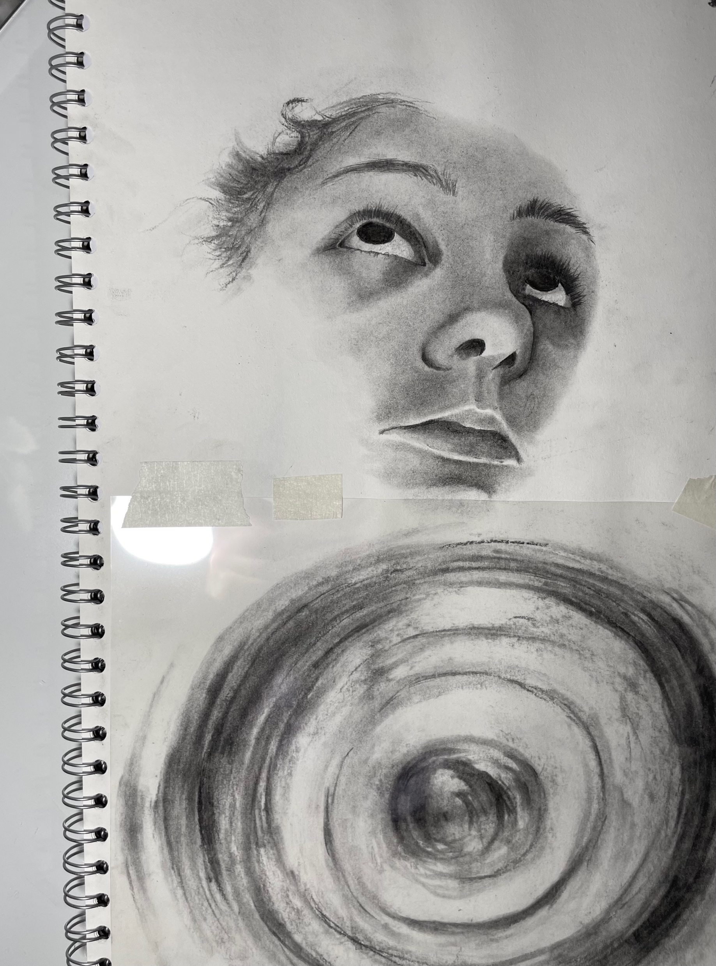
Charcoal
My love of charcoal has worked its way into many of the themes I've covered in my journey. I discovered how charcoal can create not only bold expressive pieces but can be used to create beautiful delicate pieces of art.
After watching the 2019 film "Joker" I was heavily influenced to create a piece that embodied societal exclusion and the struggles behind mental illness, this is where the idea for this outcome stemmed from. The film itself was art, its awareness of the struggles surrounding self-esteem, mental illness and societies expectations inspired me to explore these themes further through art.

Slide 5
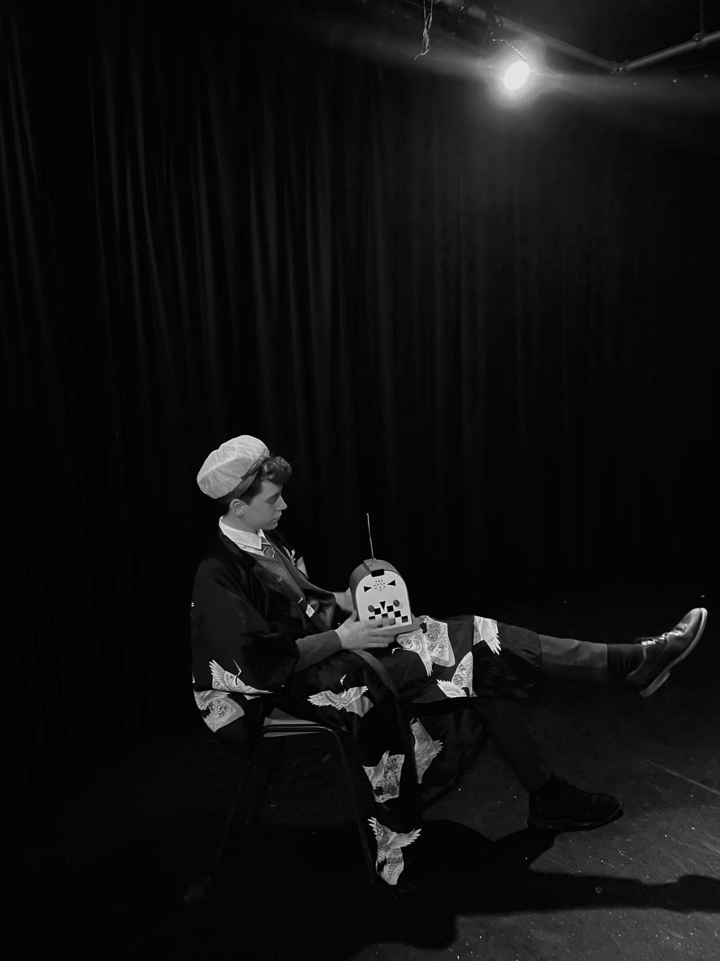
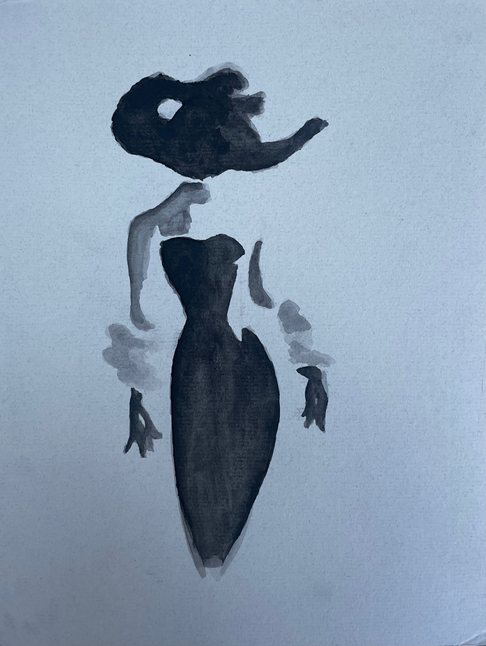
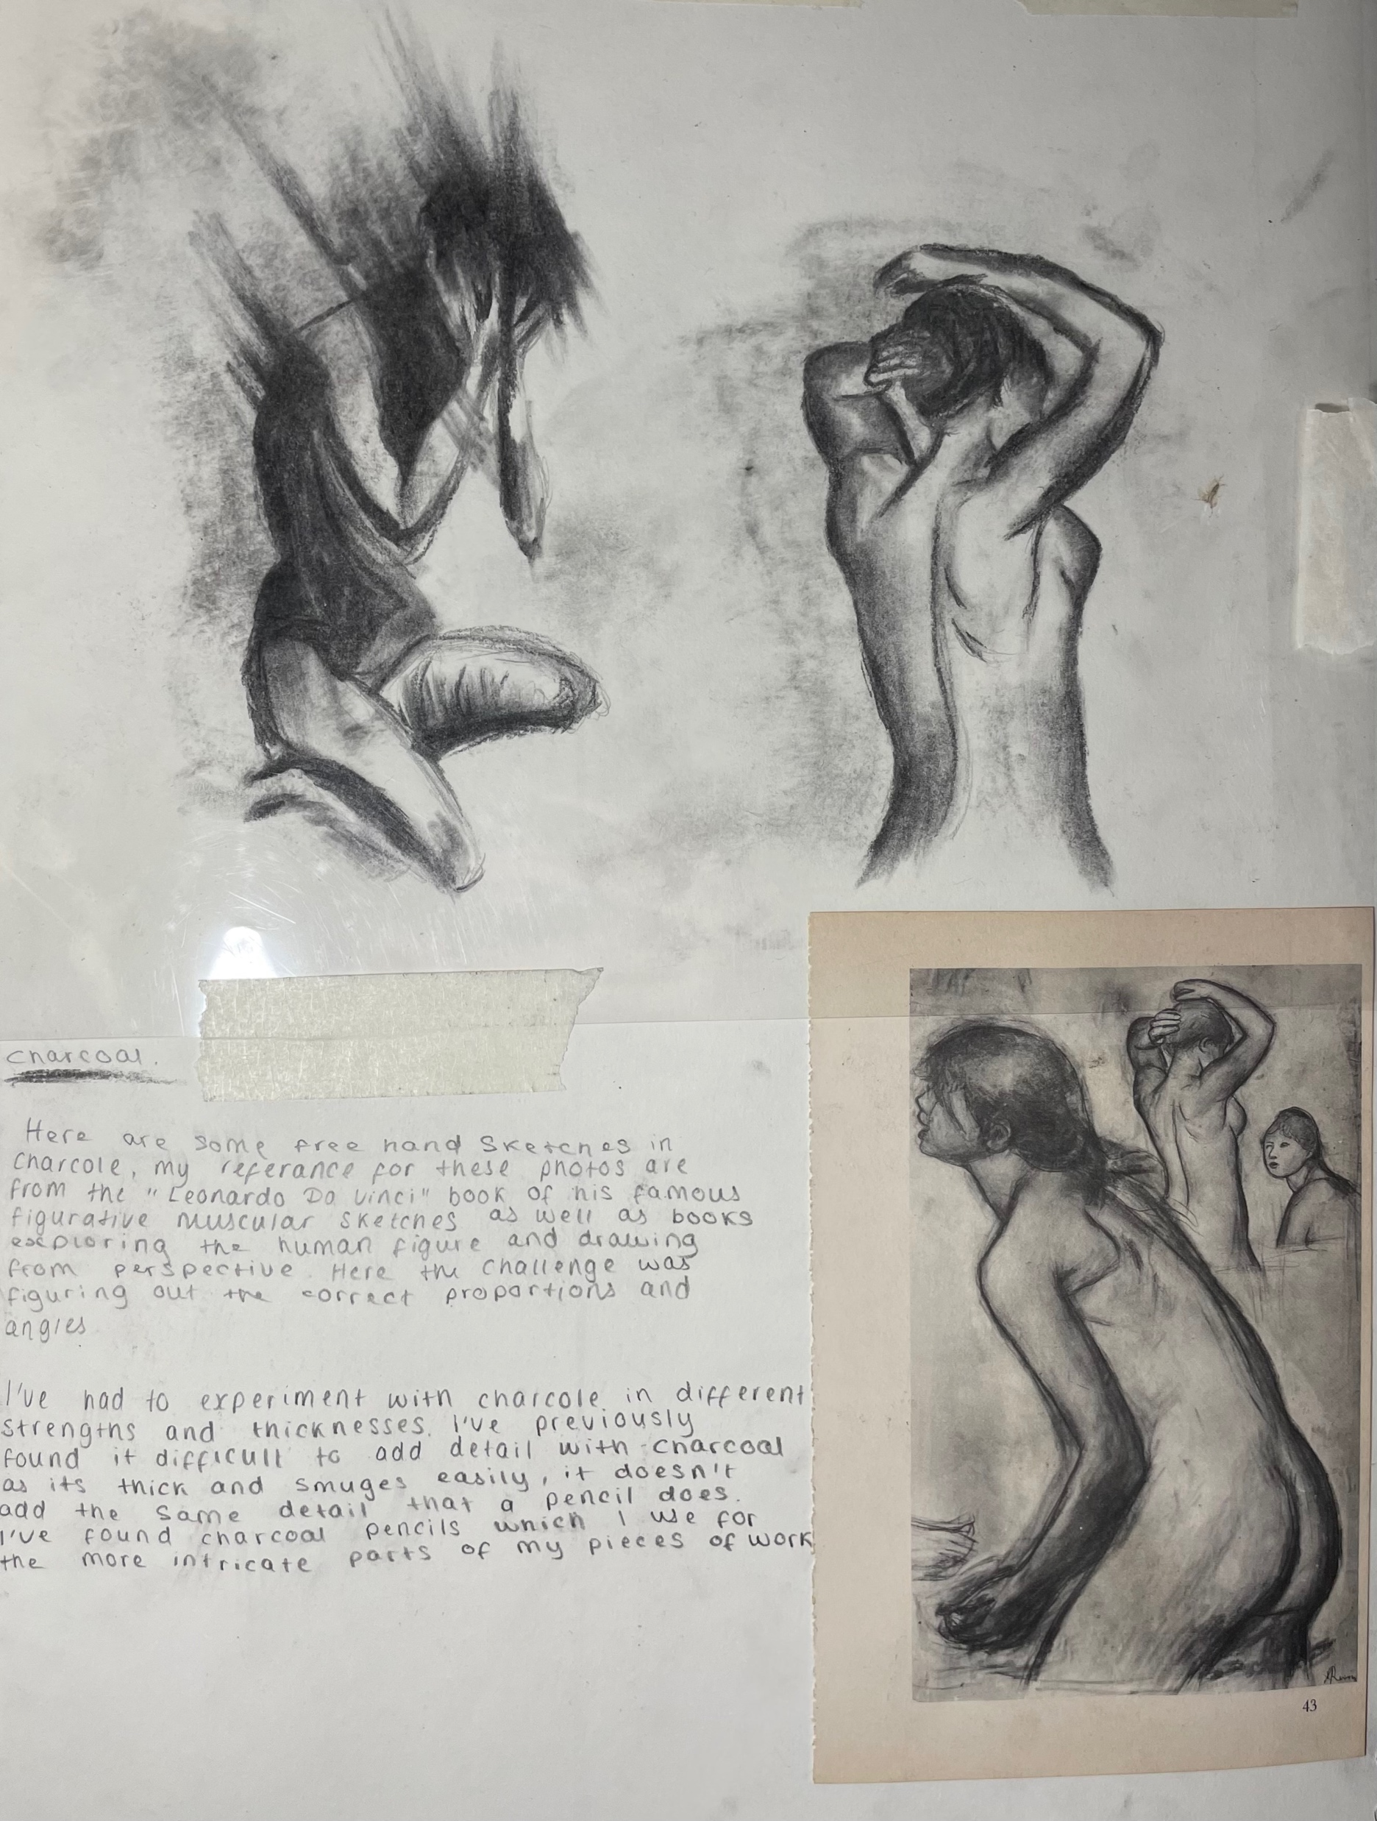
Human figure
Following my work of Anatomy, small figurative drawings are something I commonly practiced to improve my perspective, free hand drawing. Through experimentation with water colour, ink, pencil and pen I've created figurative pieces which have allowed me to understand proportion, angle and the importance of simple mark making.

Slide 6
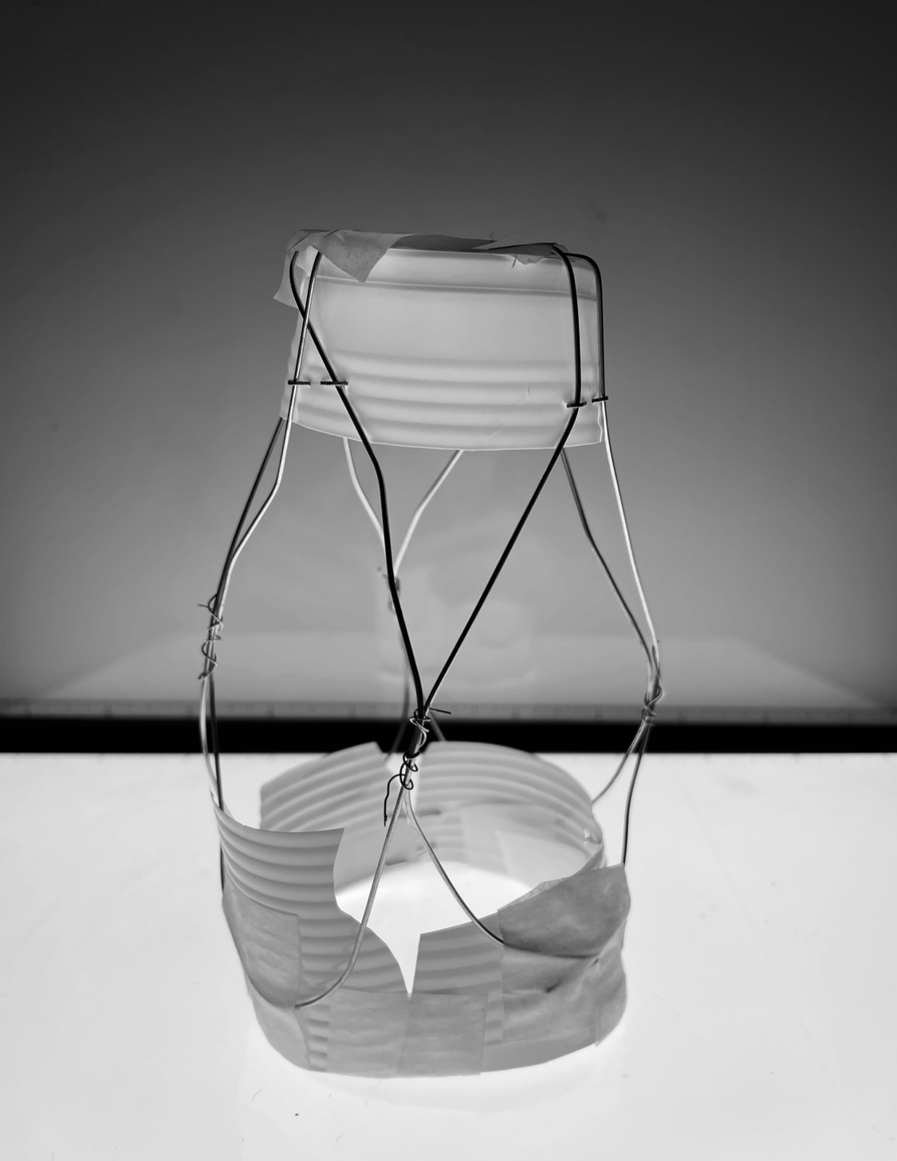
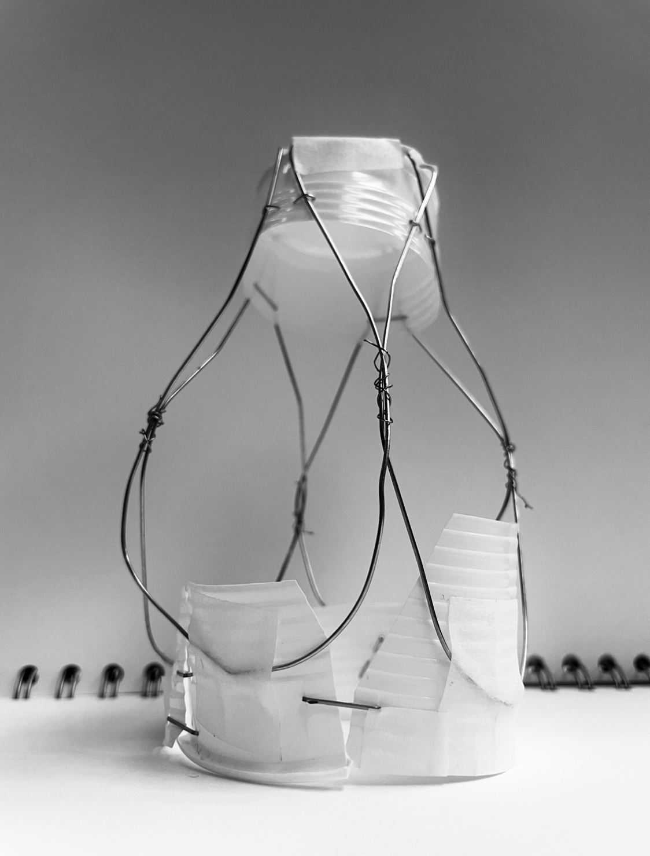
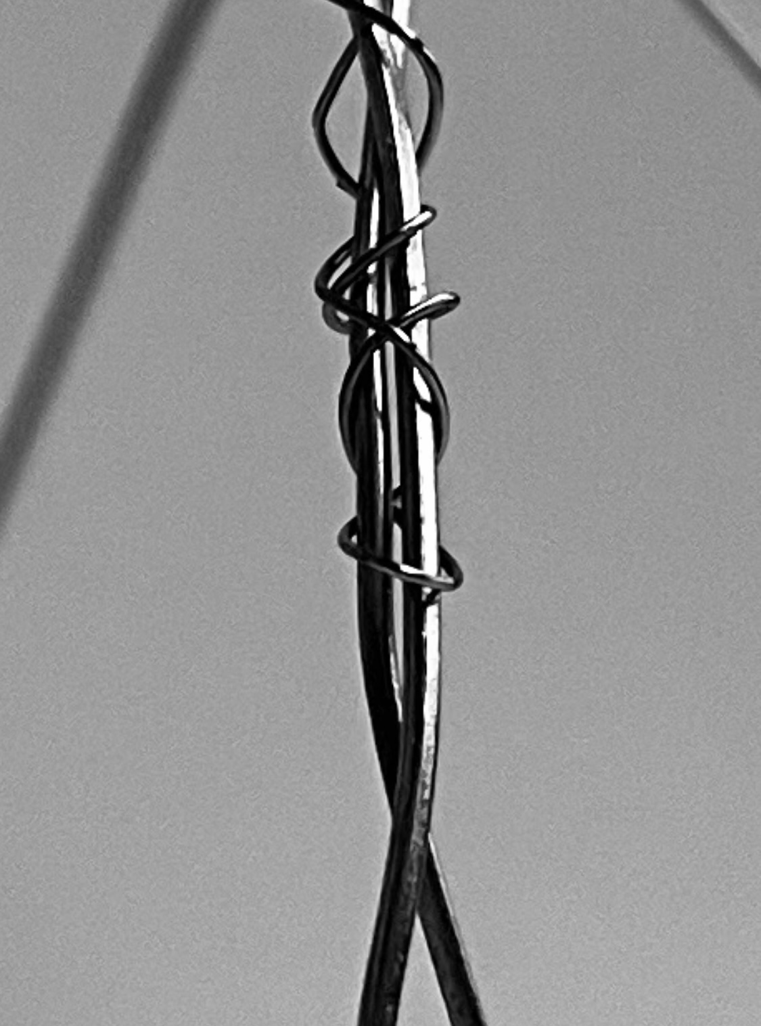
Structural experimentation
At the beginning of the year I explored and experimented with the art of destruction following along the lines of Julia Llerena, an artist who specializes in artistic reconstruction and works with lots of fragments. Towards the end of the year I noticed connections between the structural work and my architectural artwork. I decided to include structural 3D elements on to my architectural drawings which tied the two topics together perfectly. Through this experimentation I also ended up producing a set of photography which I used in later works, I took the theme of connection from the wires that led me on to study the artist Nunzio Paci. This work broadened my perspective on what art can be. Art can be anything.

Slide 7
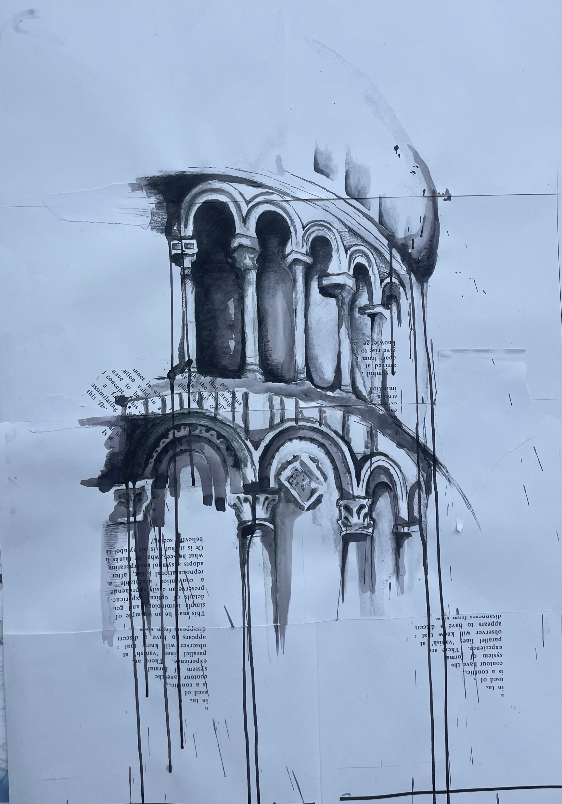
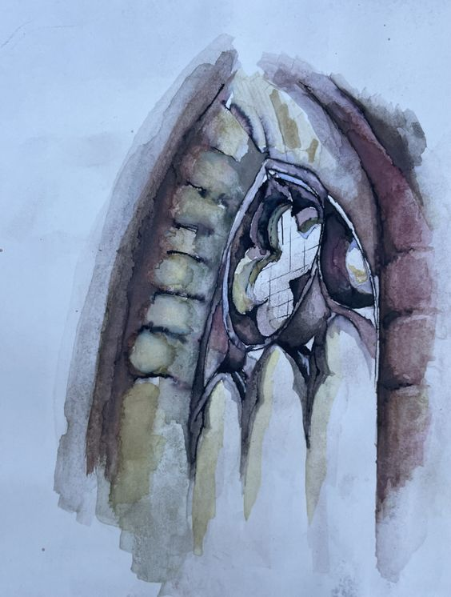
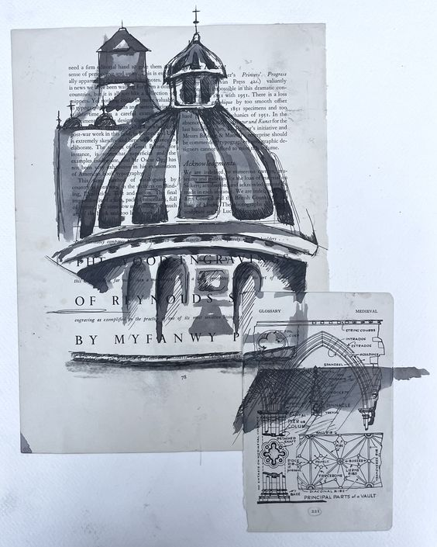
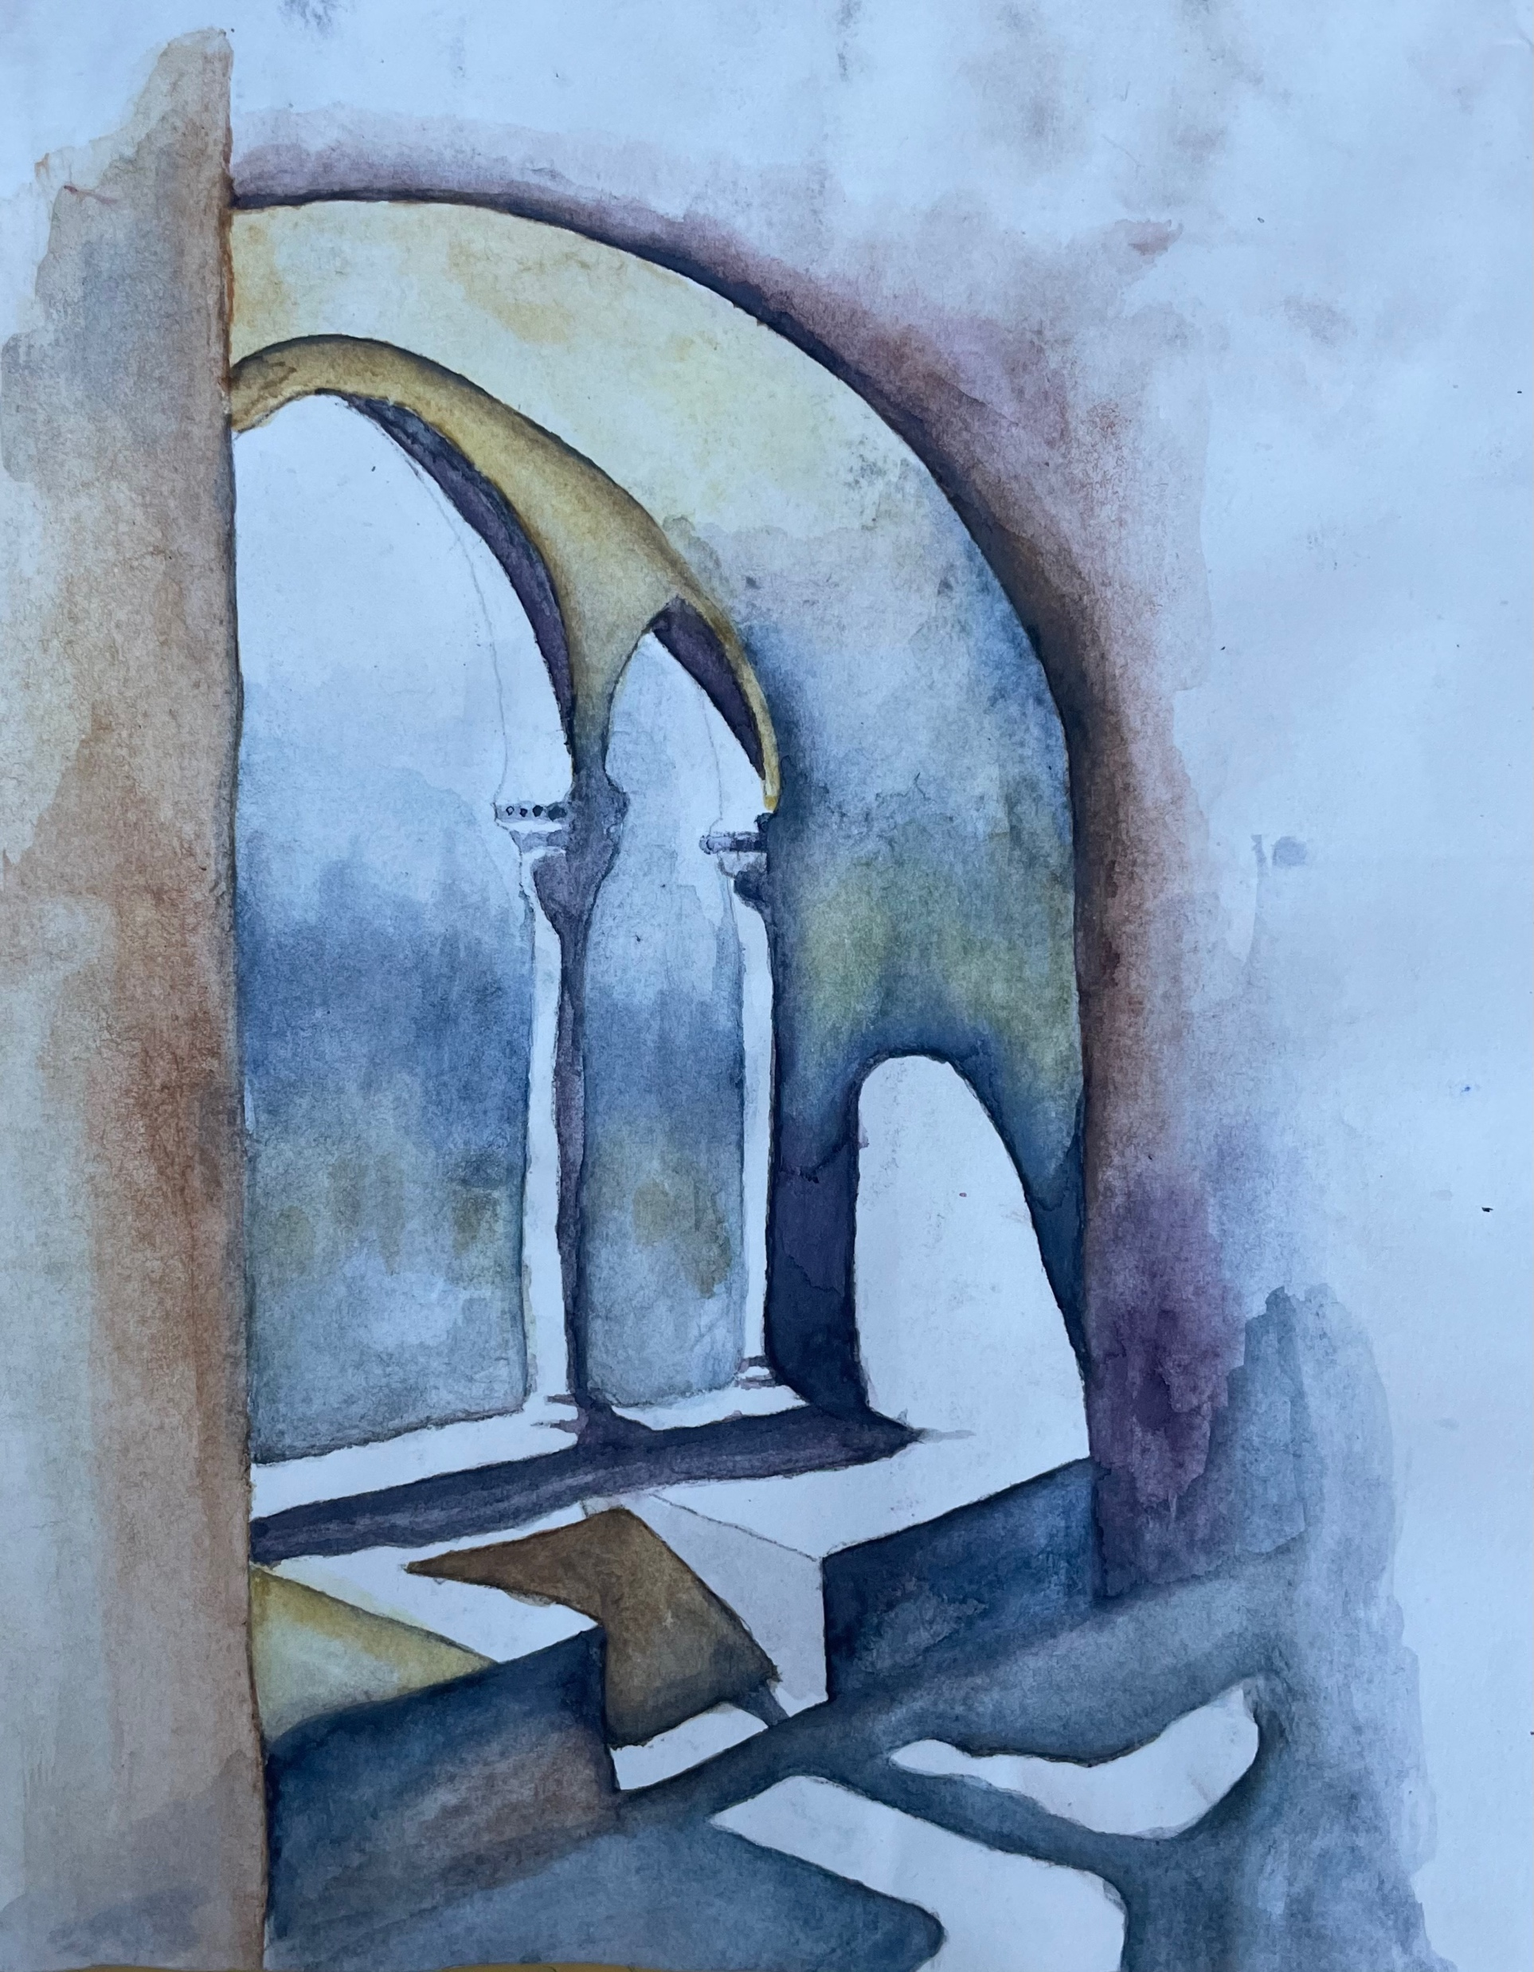
Architecture
I've been infatuated with using mixed media to create large scale architectural artwork. This style has developed a result of my newly found expression and openness. Sunga Park and Ian Murphy are two artists I've drawn enormous inspiration from regarding my architectural work. Ian Murphy in particular is an artist I've always admired for his powerful atmospheric mixed media work. I used mixed media to create the black and white pieces, I hope to continue and develop this style in the future and push myself to include more 3D elements and continue to work on a large scale. This year I've also developed my skill in water colour through looking at artists like Jogn Singer Sargent and J.M.W Turner. Their beautiful landscape and architectural work influenced me to better my skill .

