Slide 1
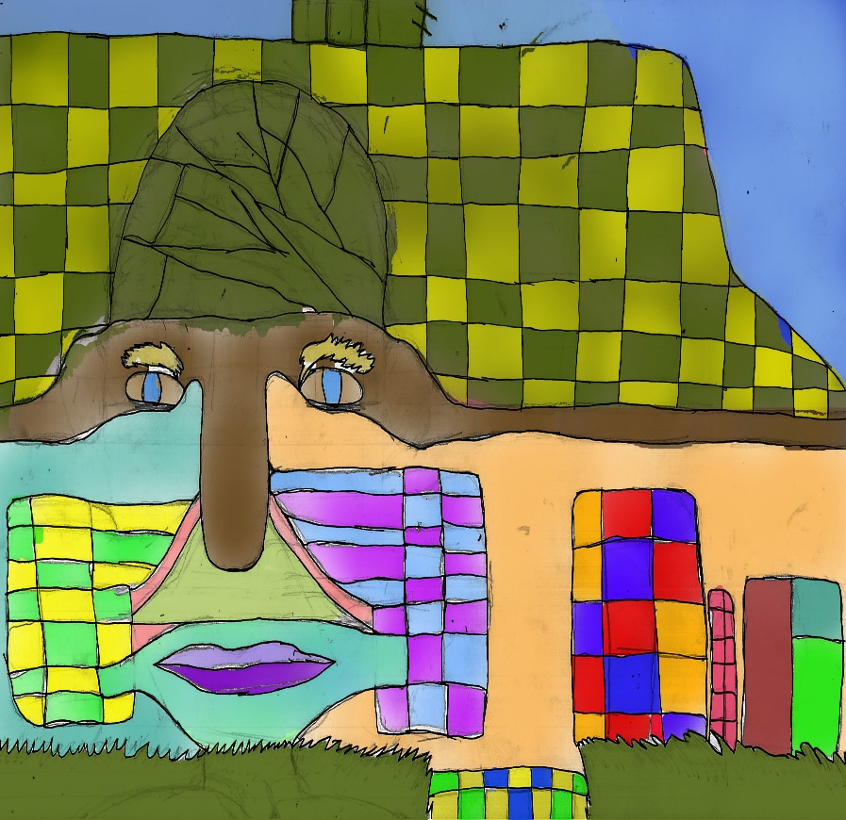
YEAR 7/8 LAYERS SELECTION TOOLS AND BRUSHES

Slide 2
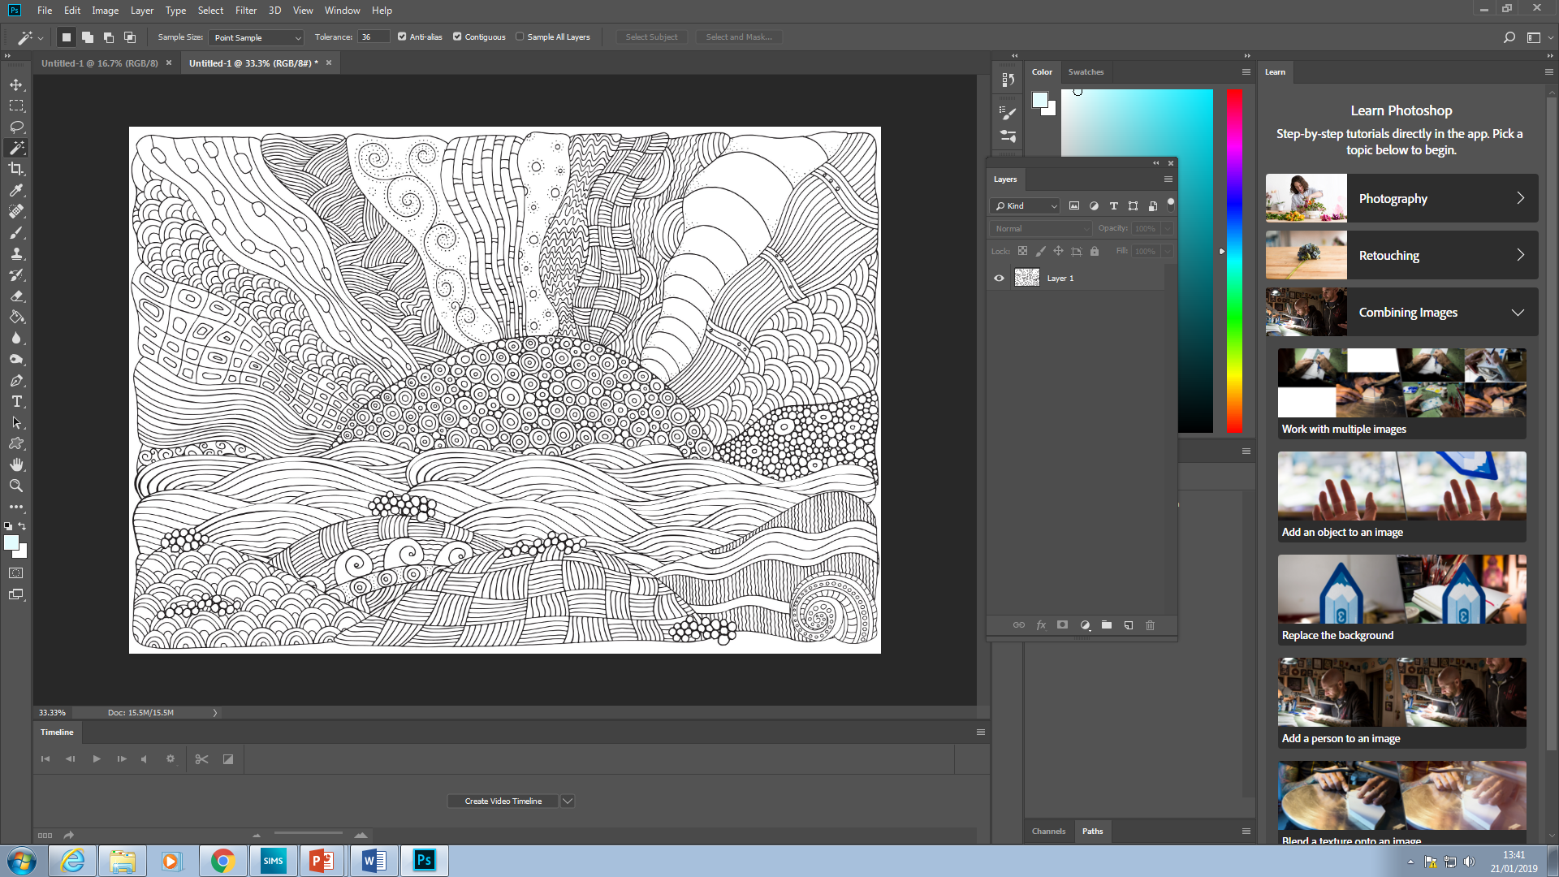
Open drawing in photoshop use keyboard shortcut to copy and paste drawing ctrl A ctrl C ctrl V

Slide 3
Rename layer to LINE and then change normal opacity to multiply then lock layer by clicking on lock
Rename bottom layer colour

Slide 4
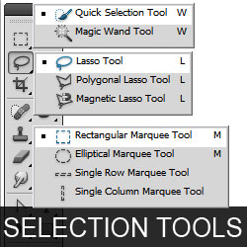
Using selection tools
We will be using either the magnetic lasso or magic wand
You might have to right click on the quick selection or lasso tool to access this

Slide 5
Using magic wand as a selection tool Click on section you wish to work in

Slide 6
If you want to pick more than one section click here this will let you chose as many parts of the image as you want.

Slide 7
Using paint bushes to apply colour
CLICK HERE TO SELECT PAINT MODE
CLICK HERE AND CHANGE OPACITY TO 15-25
CHOOSE YOUR COLOUR AND GO

Slide 8
USING MAGNETIC LASSO
Click on magnetic lasso and using the small arrow head locate the line or edge you wish to follow moving the cursor slowly along the line your selection should snap to the line click the left button to stick your selection. If you make a mistake double click the mouse and then hit ctrl d and start again . Continue to follow your chosen line until you return to the beginning and you will see this small “o” click on mouse and you should have a new selection USE THE BRUSH TOOL TO ADD COLOUR

